Slide 1
Earnings-related Pension System in Graphs and Figures
The slideshow includes key information of the Finnish earnings-related pension system.
30.4.2020

Slide 2
Pension System and Governance

Slide 3
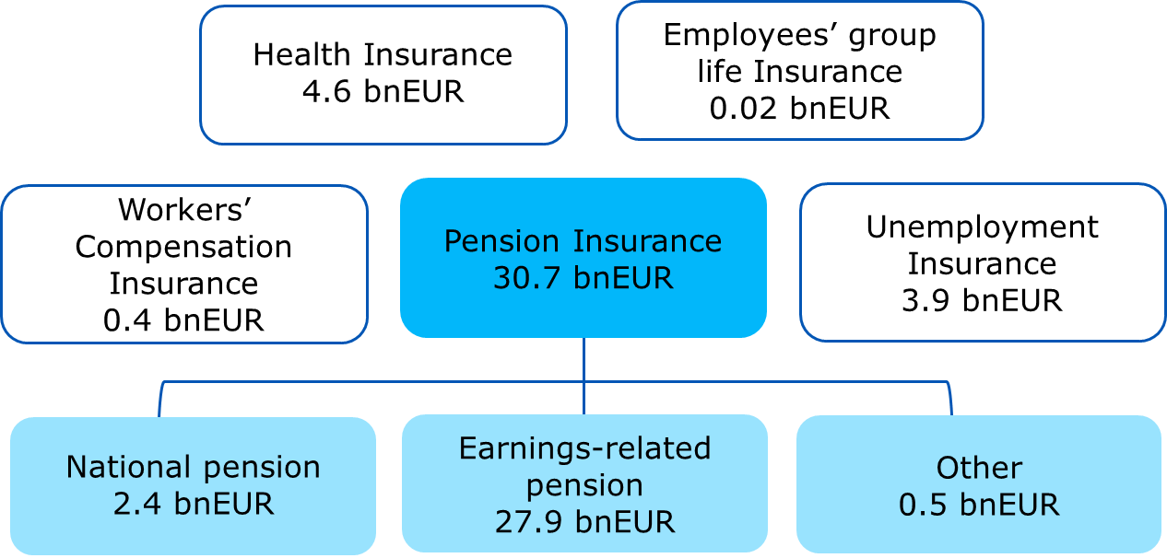
Social security insurance in 2018 40 bnEUR

Slide 4
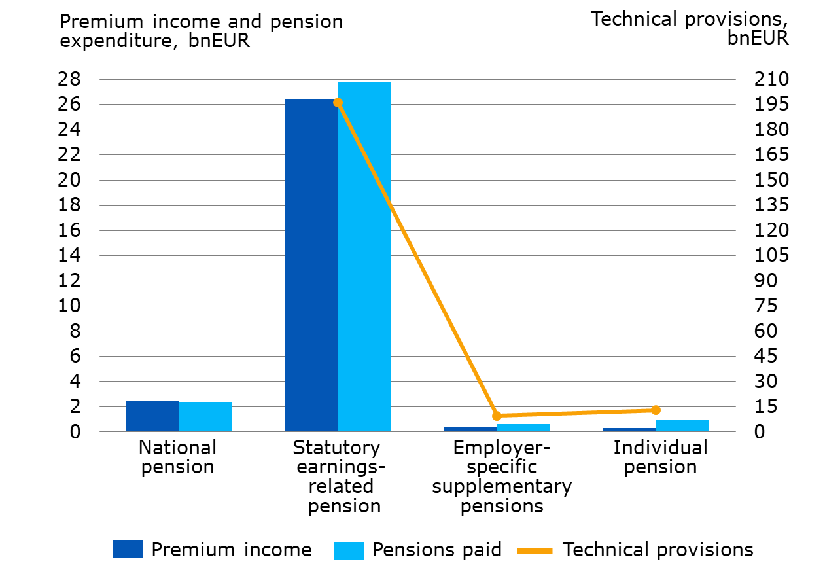
Pension insurance in Finland in 2018
Notes:
National pension in proportion to premium income and expenditure.

Slide 5
Basic pension provision

Slide 6
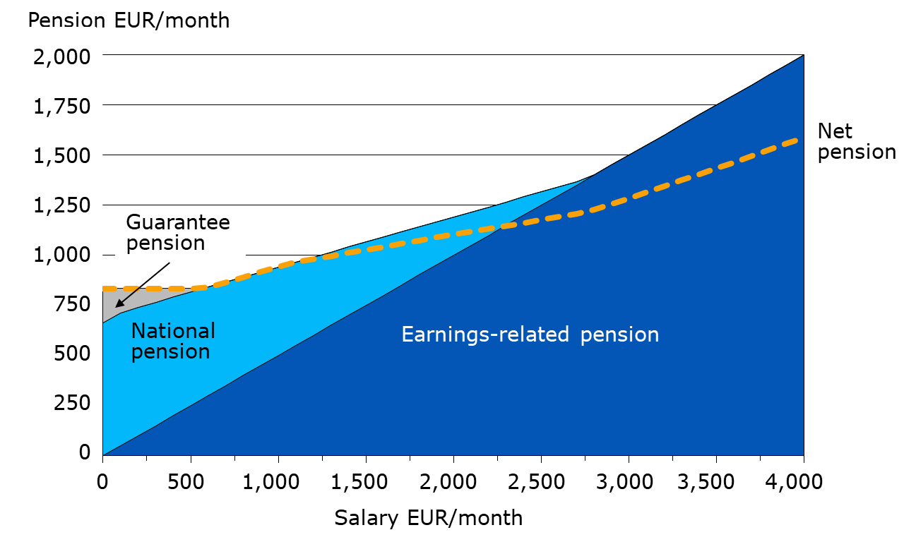
Total pension in 2020
Notes:
Single retiree, earnings-related pension is assumed to be 50 per cent of wages.
The national and guarantee pensions start at the of age 65.
Net pension means the total pension in hand after taxation, assumed that the pension recipient does not have any other income.

Slide 7
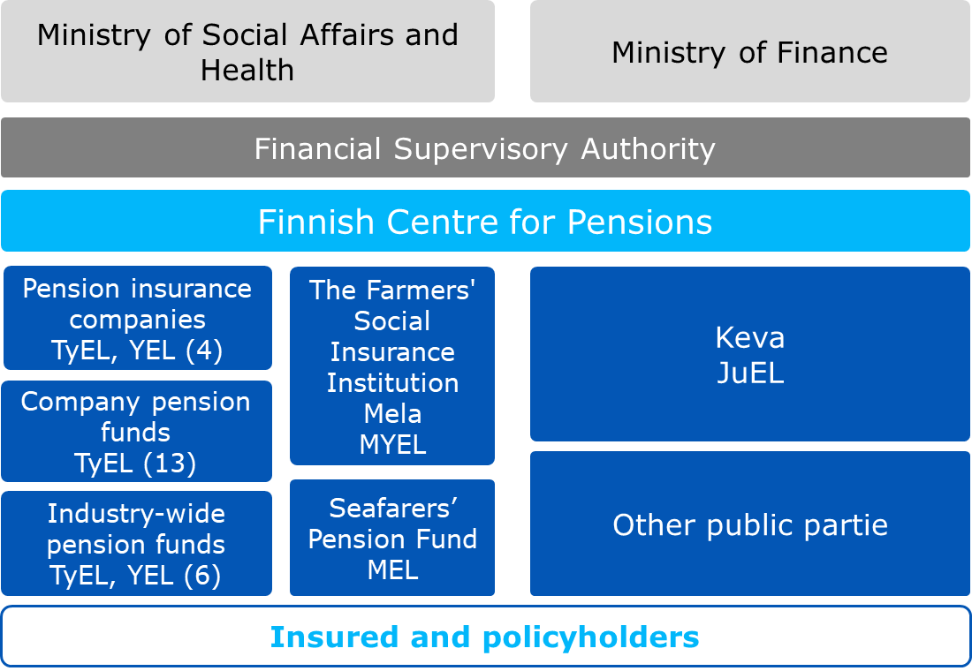
Execution in Earnings-related Pension System
Notes:
Situation in the beginning of year 2020.
Other public actors: The Orthodox Church, Bank of Finland, the Government of Åland.
Keva handles the pensions of Kela’s employees.

Slide 8
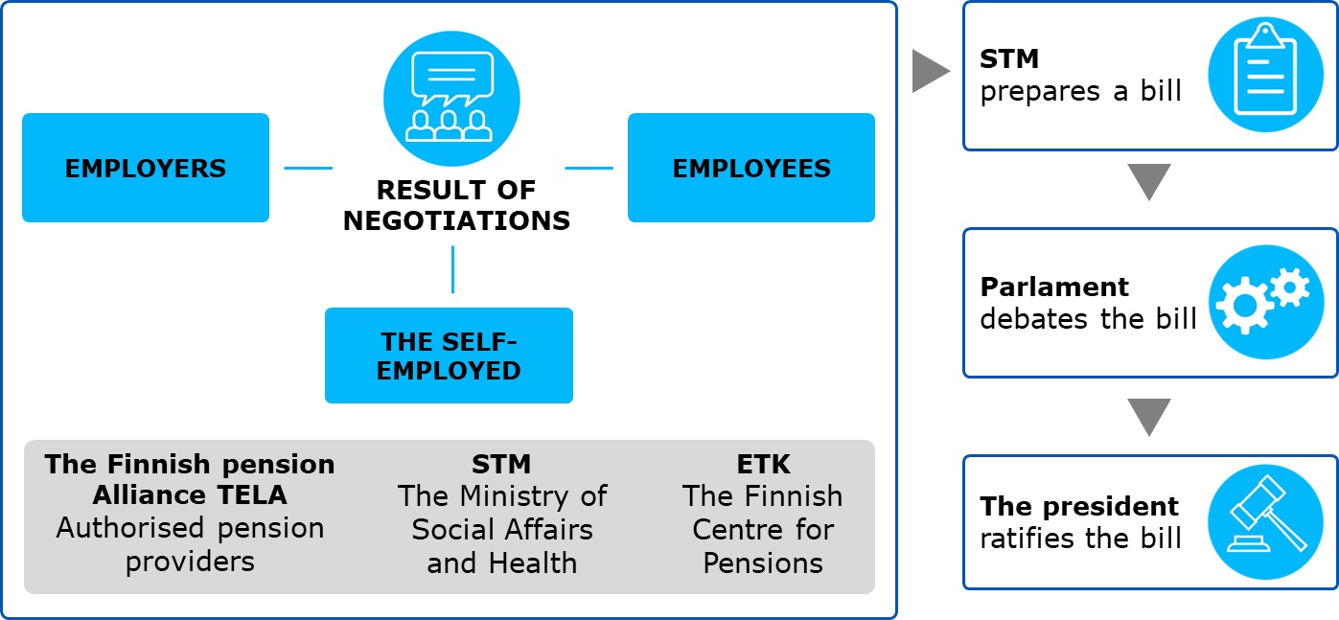
Preparation and coming into force of earnings-related pension acts

Slide 9
Determining the Pension

Slide 10
Basic pension provision

Slide 11
Total pension in 2020
Notes:
Single retiree, earnings-related pension is assumed to be 50 per cent of wages.
The national and guarantee pensions start at the of age 65.
Net pension means the total pension in hand after taxation, assumed that the pension recipient does not have any other income.

Slide 12
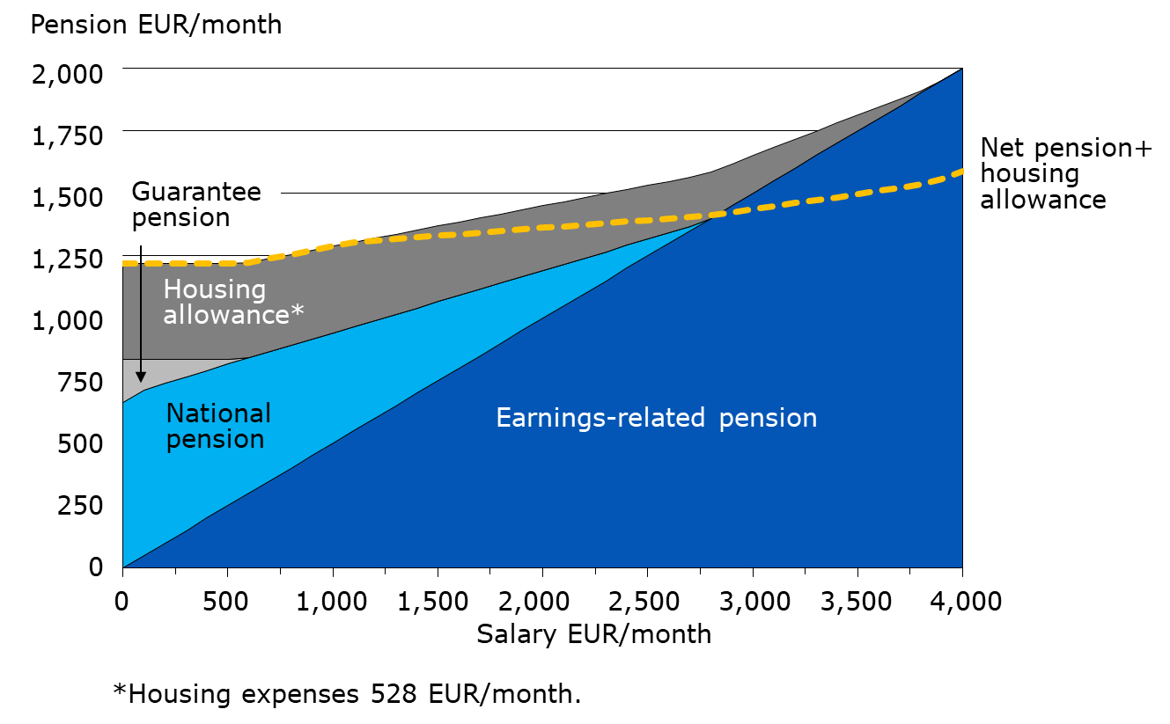
Total pension in 2020, including housing allowance
Notes:
Single retiree, earnings-related pension is assumed to be 50 per cent of wages.
The national and guarantee pensions start at the of age 65.
Net pension means the total pension in hand after taxation, assumed that the pension recipient does not have any other income.

Slide 13
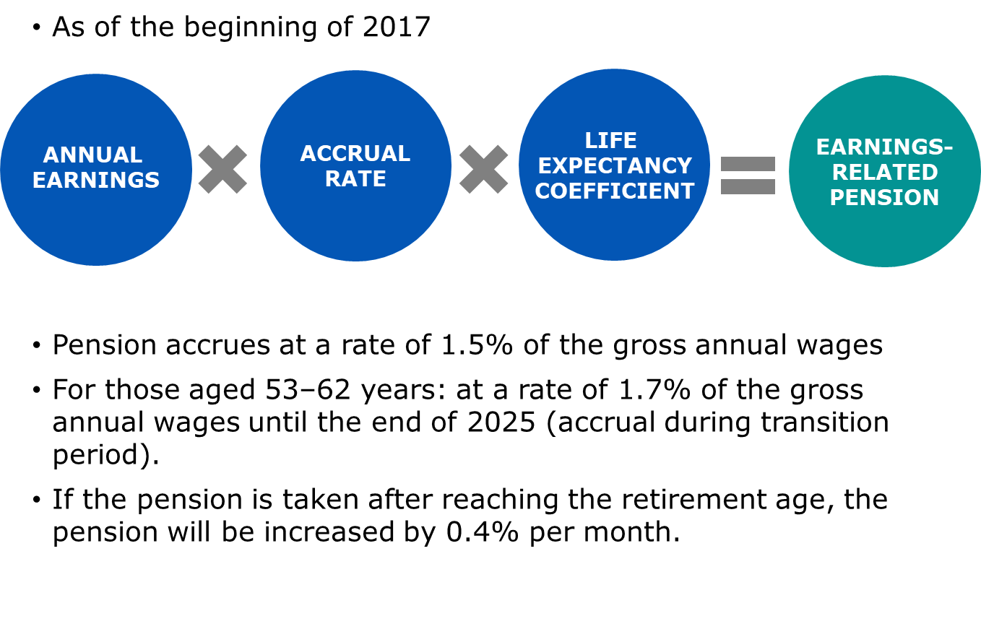
Pension accrues from work
Notes:
Pension accrues from the month after the employee turns 17 years and the self-employed person 18 years.
As of 2017, the employee’s earnings-related pension contribution will not be deducted from the wages on which the pension is based.
Pension accrual rates from 2005 to 2016:
1.5% for persons under the age of 53,
1.9% for persons between the ages of 53 and 62 years, and
4.5% for persons between the ages of 63 and 67 years.

Slide 14
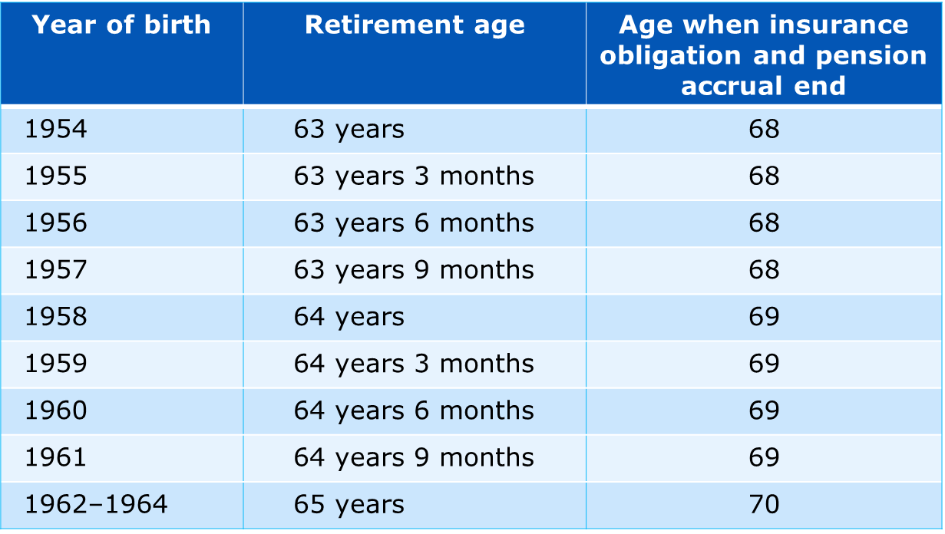
Retirement age rises by birth group
Notes:
The retirement age of employees born in 1965 and later will be linked to life expectancy. The retirement age will be confirmed by a decree issued by the Ministry of Social Affairs and Health in the year in which the employee turns 62 years.

Slide 15
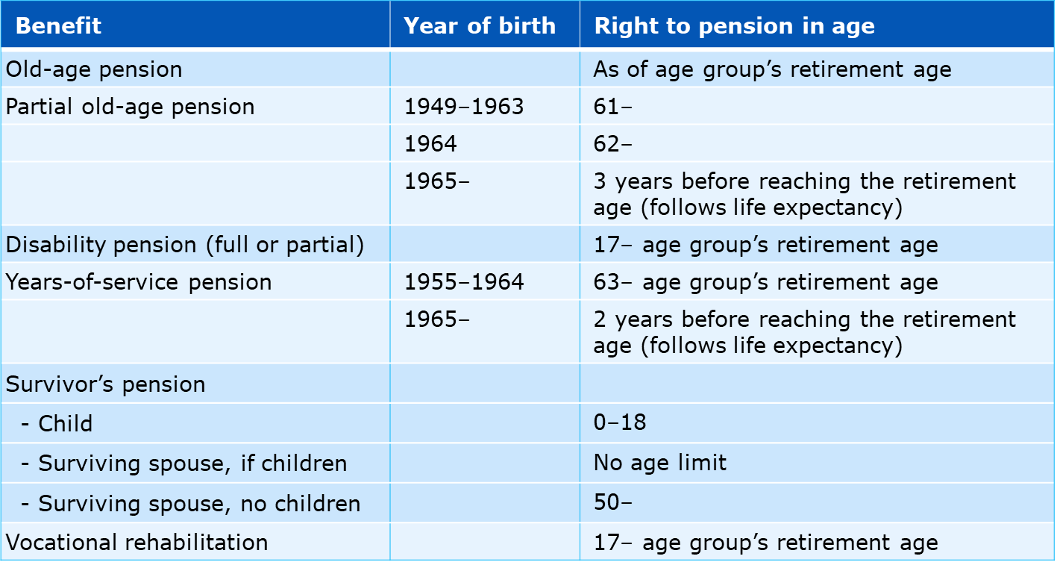
Age limits of earnings-related pensions

Slide 16
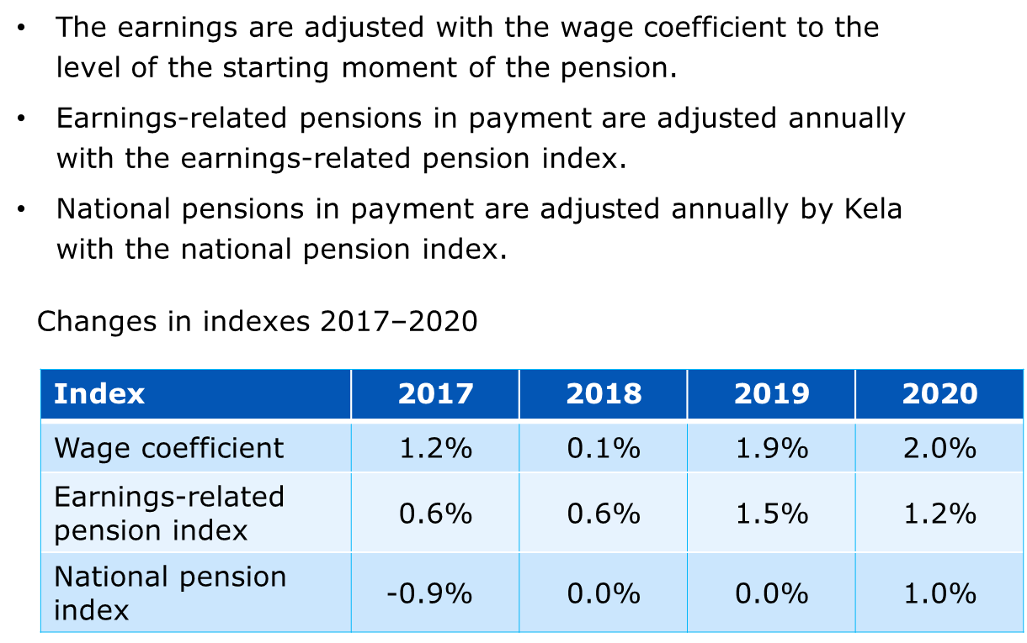
Index adjustments secure pension level
Notes:
The index adjustment amount is affected by the changes in the consumer price and income level index calculated by Statistics Finland.
In the wage coefficient, the share of change in price level is 20 per cent and the share of wage-earners’ income level is 80 percent.
In the earnings-related pension index, the share of change in price level is 80 per cent and the share of wage-earners’ income level is 20 percent.

Slide 17
Pension Level

Slide 18
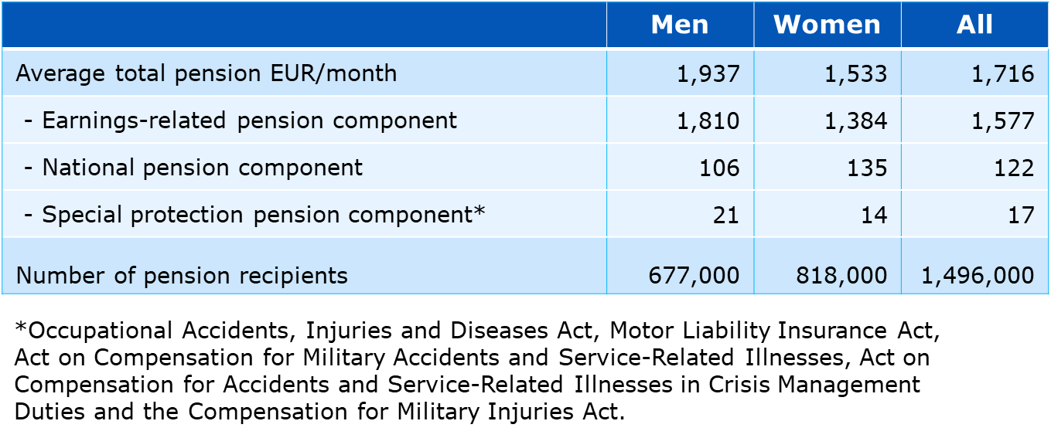
Average total pension on 31 Dec. 2019
Notes:
Pension recipients: Individuals residing in Finland who receive an old-age, disability or a special pension for farmers from the earnings-related or national pension scheme. Individuals who get a partial old-age pension are not included in the figures.
The total pension includes the pension in one’s own right and survivors’ pension components.
The total pension includes earnings-related pension, national pension, guarantee pension and special protection pensions components.
The total pension is a gross pension.
Statistical database
https://tilastot.etk.fi/pxweb/en/ETK/ETK__110kaikki_elakkeensaajat__20elakkeensaajien_elake/elsael_1k01_laji.px
Statistical Yearbook of Pensioners in Finland
https://www.etk.fi/en/statistics-2/statistics/pension-recipients/all-pension-recipients/

Slide 19
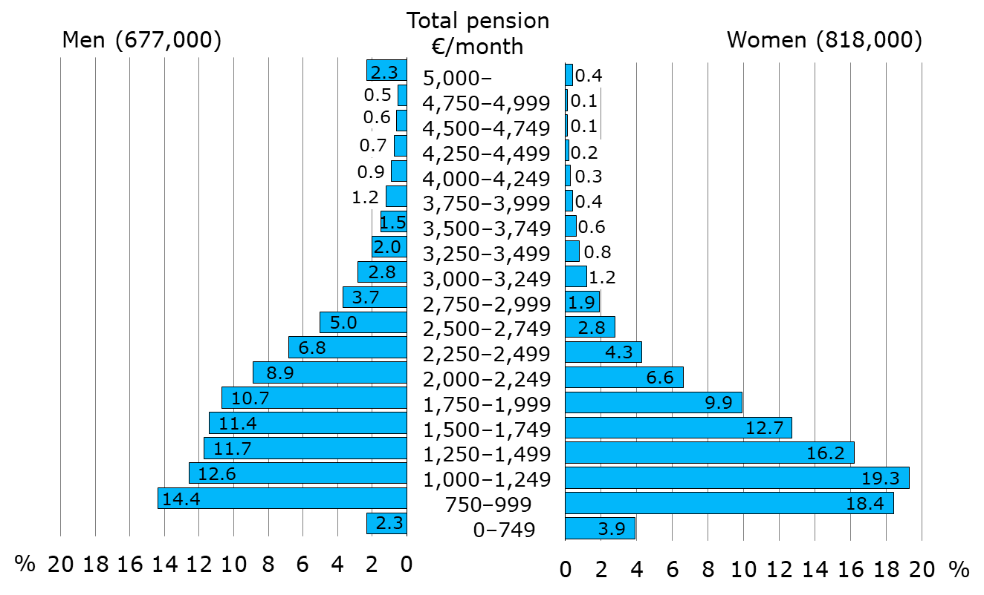
Total pension distribution of pension recipients on 31 Dec. 2019
Notes:
Pension recipients: Individuals residing in Finland who receive an old-age, disability or a special pension for farmers from the earnings-related or national pension scheme. Individuals who get a partial old-age pension are not included in the figures.
The total pension includes the pension in one’s own right and survivors’ pension components.
The total pension includes earnings-related pension, national pension, guarantee pension and special protection pensions components (Occupational Accidents, Injuries and Diseases Act, Motor Liability Insurance Act, Act on Compensation for Military Accidents and Service-Related Illnesses, Act on Compensation for Accidents and Service-Related Illnesses in Crisis Management Duties and the Compensation for Military Injuries Act).
The total pension is a gross pension.
Statistical Yearbook of Pensioners in Finland
https://www.etk.fi/en/statistics-2/statistics/pension-recipients/all-pension-recipients/

Slide 20
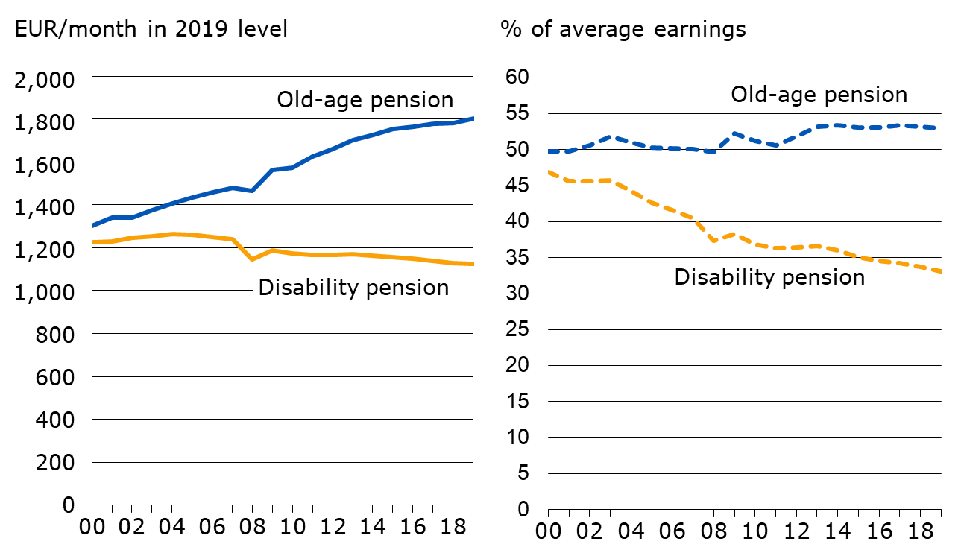
Average total pension and its ratio to average earnings in 2000–2019
Notes:
Pension recipients: Individuals residing in Finland who receive an old-age or disability pension from the statutory earnings-related or national pension scheme.
The total pension includes the pension in one’s own right and survivors’ pension components.
The total pension includes earnings-related pension, national pension, guarantee pension and special protection pensions components (Occupational Accidents, Injuries and Diseases Act, Motor Liability Insurance Act, Act on Compensation for Military Accidents and Service-Related Illnesses, Act on Compensation for Accidents and Service-Related Illnesses in Crisis Management Duties and the Compensation for Military Injuries Act).
As of year 2008, the total pension no longer includes pensioners’ housing and care allowance components. As of 2011, the total pension includes the guarantee pension component.
The total pension is a gross pension.
The average earning is based on the Income distribution statistics of Statistics Finland, which contains data on average earned and entrepreneurial incomes.

Slide 21
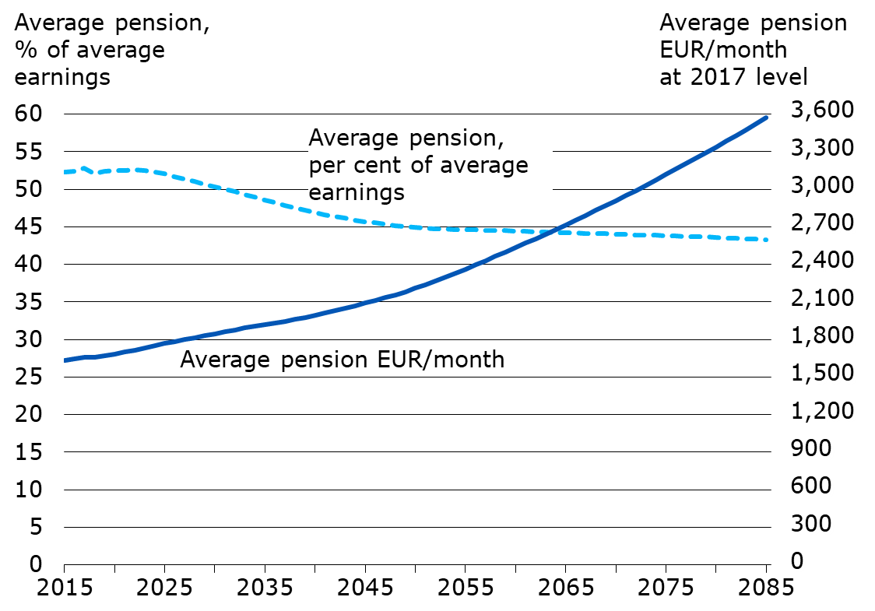
Average total pension and its ratio to average earnings in 2015–2085
Notes:
https://www.etk.fi/en/forecasts/forecasts/long-term-projections/
Pension recipients: Individuals residing in Finland who receive an old-age, disability or a special farmer’s pension from the earnings-related or national pension scheme.
The total pension includes the pension in one’s own right and survivors’ pension components.
The total pension includes earnings-related pension, national pension, guarantee pension and special protection pensions components (Occupational Accidents, Injuries and Diseases Act, Motor Liability Insurance Act, Act on Compensation for Military Accidents and Service-Related Illnesses, Act on Compensation for Accidents and Service-Related Illnesses in Crisis Management Duties and the Compensation for Military Injuries Act).
The average earning is based on data on the insured individuals’ income from work and the number of insured in the earnings and accrual register of the earnings-related pension system.

Slide 22
Pension Expenditure

Slide 23
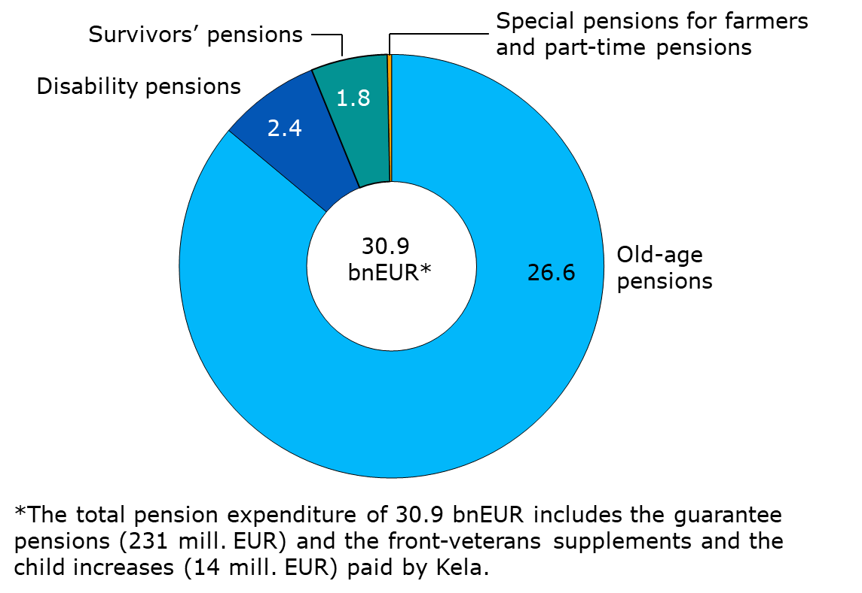
Earnings-related and Kela pension expenditure in 2019
Notes:
Part-time pensions 18 mill.€, special pensions for farmers 46 mill.€.
Statistical database
https://tilastot.etk.fi/pxweb/en/ETK/ETK__140elakemenot/emeno03_laji.px

Slide 24
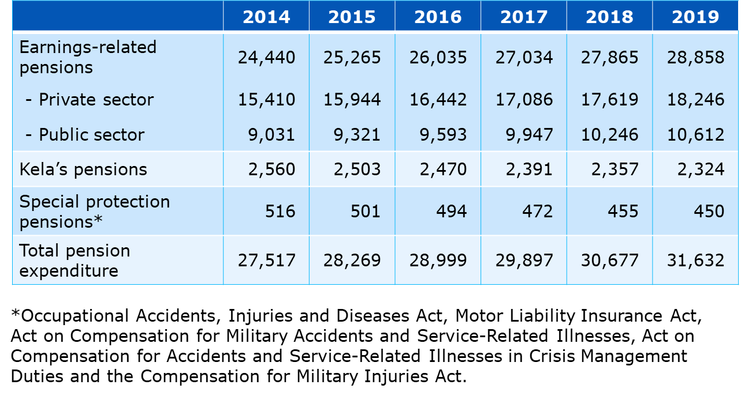
Statutory total pension expenditure in 2014–2019, mEUR
Notes:
The total pension expenditure includes old-age, disability, unemployment (2014), survivors’ and part-time pensions, as well as special pensions for farmers, paid from different pension systems.
Kela’s pension expenditure includes national pensions, guarantee pensions, front-veterans supplements and child increases.
Special protection pensions = Occupational Accidents, Injuries and Diseases Act, Motor Liability Insurance Act, Act on Compensation for Military Accidents and Service-Related Illnesses, Act on Compensation for Accidents and Service-Related Illnesses in Crisis Management Duties and the Compensation for Military Injuries Act.
Statistical database
https://tilastot.etk.fi/pxweb/en/ETK/ETK__140elakemenot/emeno01_koko.px

Slide 25
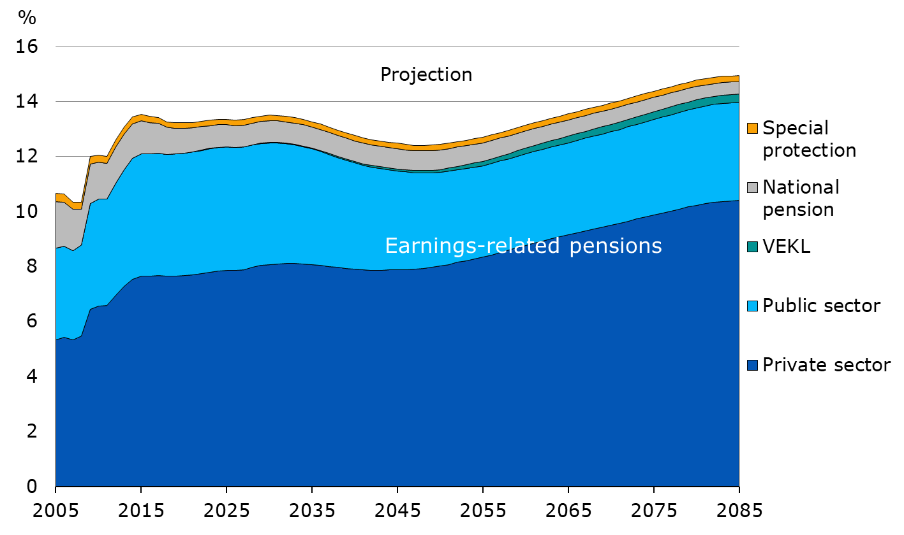
Pension expenditure, per cent of GDP in 2005–2085
Notes:
https://www.etk.fi/en/forecasts/forecasts/long-term-projections/
Kela’s pension expenditure includes national and guarantee pensions.
Special protection = Occupational Accidents, Injuries and Diseases Act, Motor Liability Insurance Act, Act on Compensation for Military Accidents and Service-Related Illnesses, Act on Compensation for Accidents and Service-Related Illnesses in Crisis Management Duties and the Compensation for Military Injuries Act.
VEKL: Act on Compensation for Pension Accrual from State Funds for Periods of Childcare and Periods of Study

Slide 26
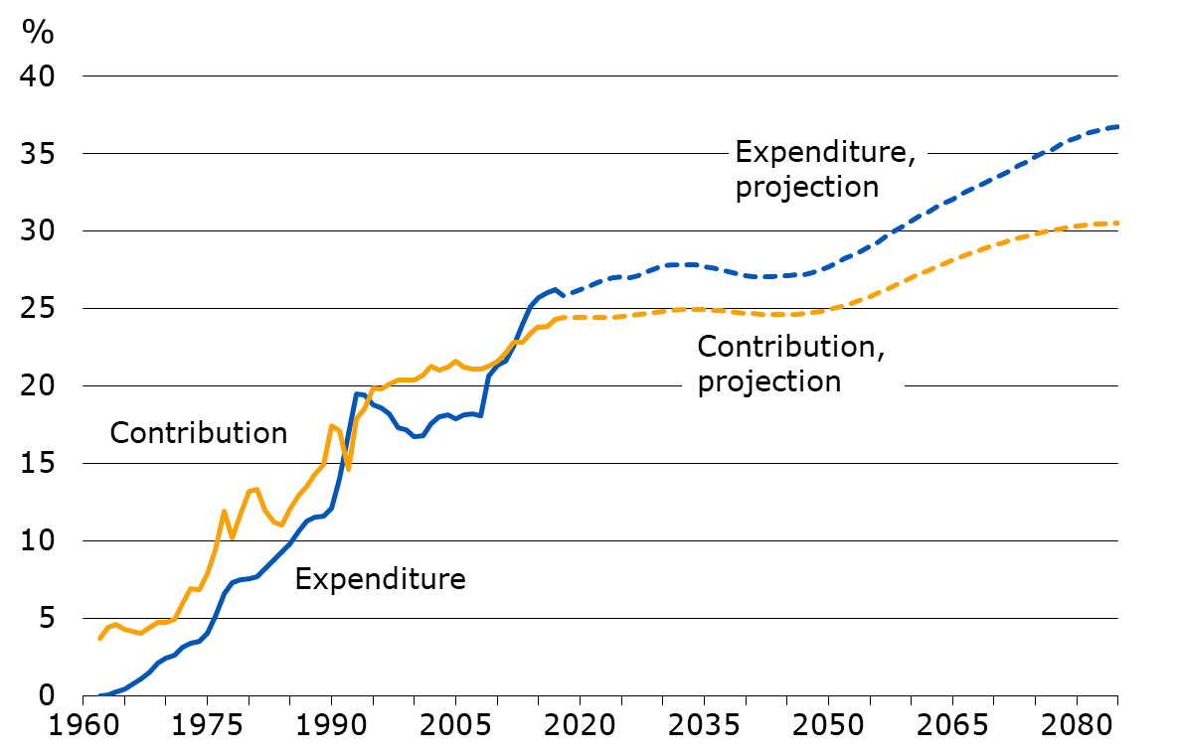
Pension expenditure and contribution rates in proportion to the wage sum under the Employees Pensions Act (TyEL) in 1962–2085
Notes:
https://www.etk.fi/en/forecasts/forecasts/long-term-projections/
The realised and projected development of private-sector employees’ pension expenditure and contributions in proportion to the equivalent wage sum.

Slide 27
Insured for Earnings-related Pension Benefits

Slide 28
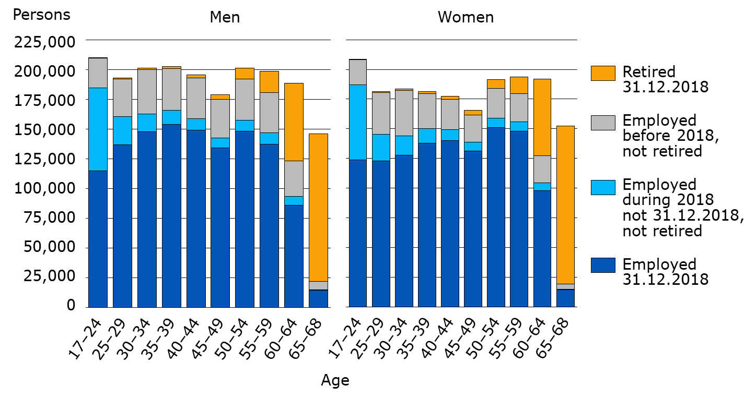
All persons aged 17–68 years covered by the earnings-related pension scheme on 31 Dec. 2018
Notes:
The figures in the graph indicate the status of individuals covered by the earnings-related pension scheme at the time of section (31 December).
Statistical database
https://tilastot.etk.fi/pxweb/en/ETK/ETK__170vakuutetut__10tyoelakevakuutetut/vak01_piiri.px
Persons insured for an earnings-related pension in Finland
https://www.etk.fi/en/statistics-2/statistics/insured-persons/

Slide 29
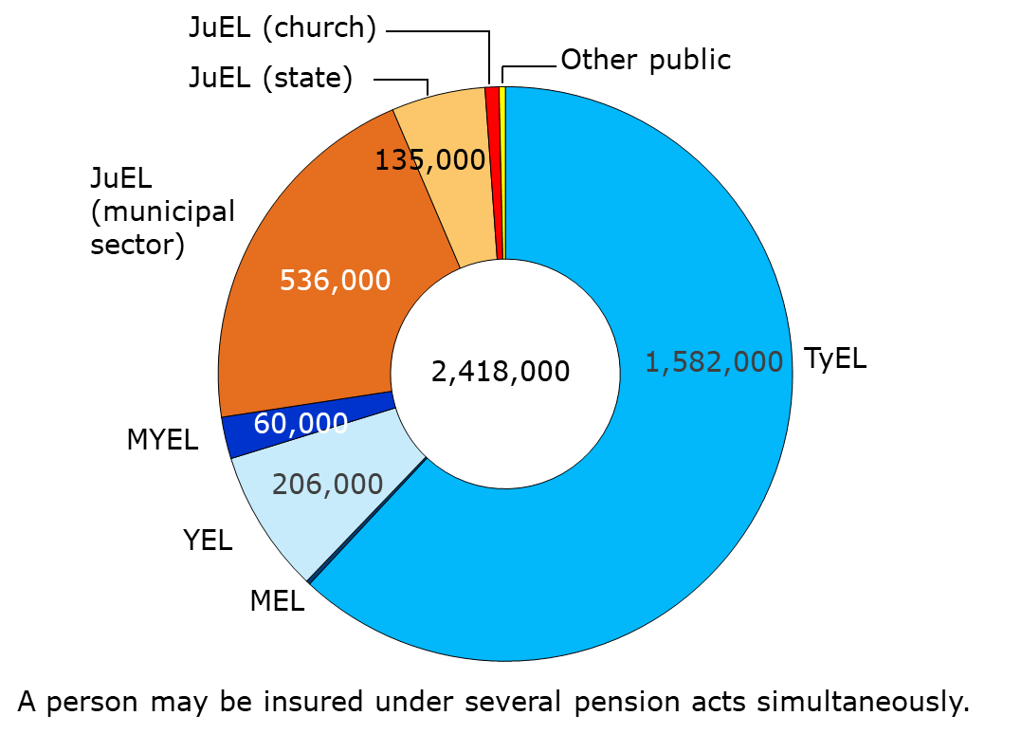
Insured persons in employment or self employment on 31 Dec. 2018, by pension act
Notes:
The figures depict the number of individuals in employment or self-employment on 31 December.
A person may be insured under several different pension acts simultaneously. In the total amount (2.4 million), each individual is counted only once.
JuEL (Municipal Sector) covers 34,000 elected officials, family caregivers, private care-providers etc.
JuEL (State) covers 10,000 elected officials, consultants etc.
TyEL = Employees Pensions Act
MEL = Seafarer’s Pensions Act
YEL = Self-employed Persons’ Pensions Act
MyEL = Farmers’ Pensions Act
JuEL= Public Sector Pensions Act (Municipal Sector, State, Church)
OrtKL = Orthodox Church Act
SP = Pension regulation for the Bank of Finland
Pension regulation for the regional government of Åland
Statistical database
https://tilastot.etk.fi/pxweb/en/ETK/ETK__170vakuutetut__10tyoelakevakuutetut/vak01_piiri.px
Persons insured for an earnings-related pension in Finland
https://www.etk.fi/en/statistics-2/statistics/insured-persons/

Slide 30
Pension Recipients

Slide 31
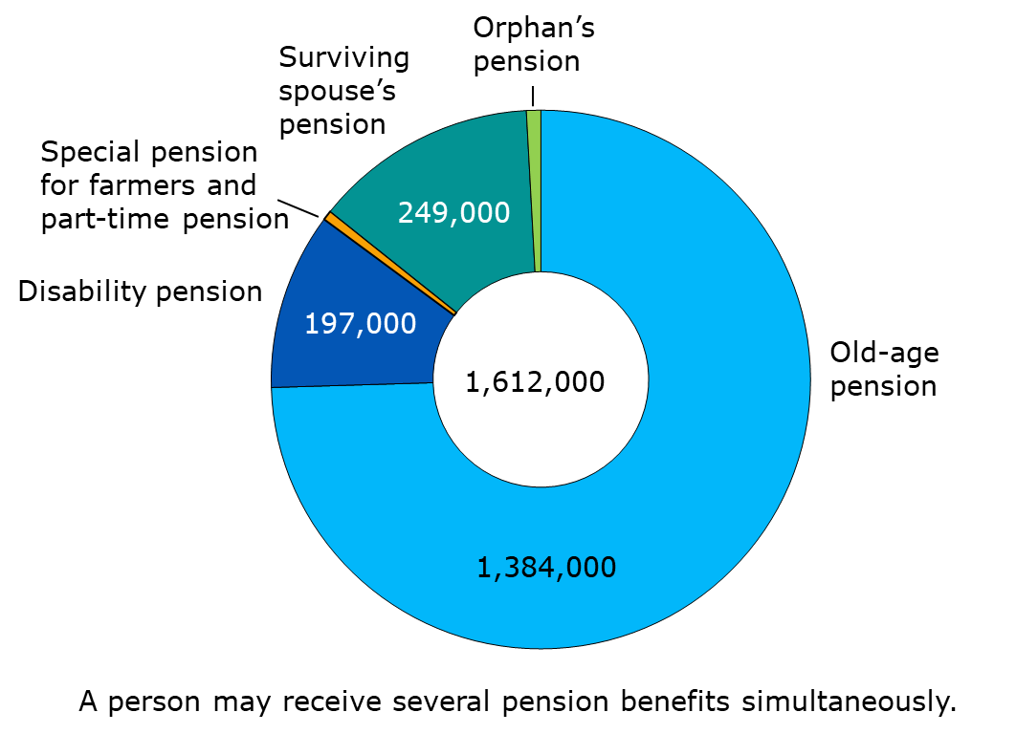
All pension recipients on 31 Dec. 2019
Notes:
Part-time pension 1,000, special pension for farmers (farm closure pension and farmers’ early retirement aid) 10,000, orphan’s pension 16,000.
The figures include all individuals receiving a pension from the earnings-related or national pension scheme.
1,556,000 pension recpients resided in Finland while 57,000 resided abroad.
Statistical database
https://tilastot.etk.fi/pxweb/en/ETK/ETK__110kaikki_elakkeensaajat__20elakkeensaajien_elake/elsael_1k01_laji.px
Statistical Yearbook of Pensioners in Finland
https://www.etk.fi/en/statistics-2/statistics/pension-recipients/all-pension-recipients/

Slide 32
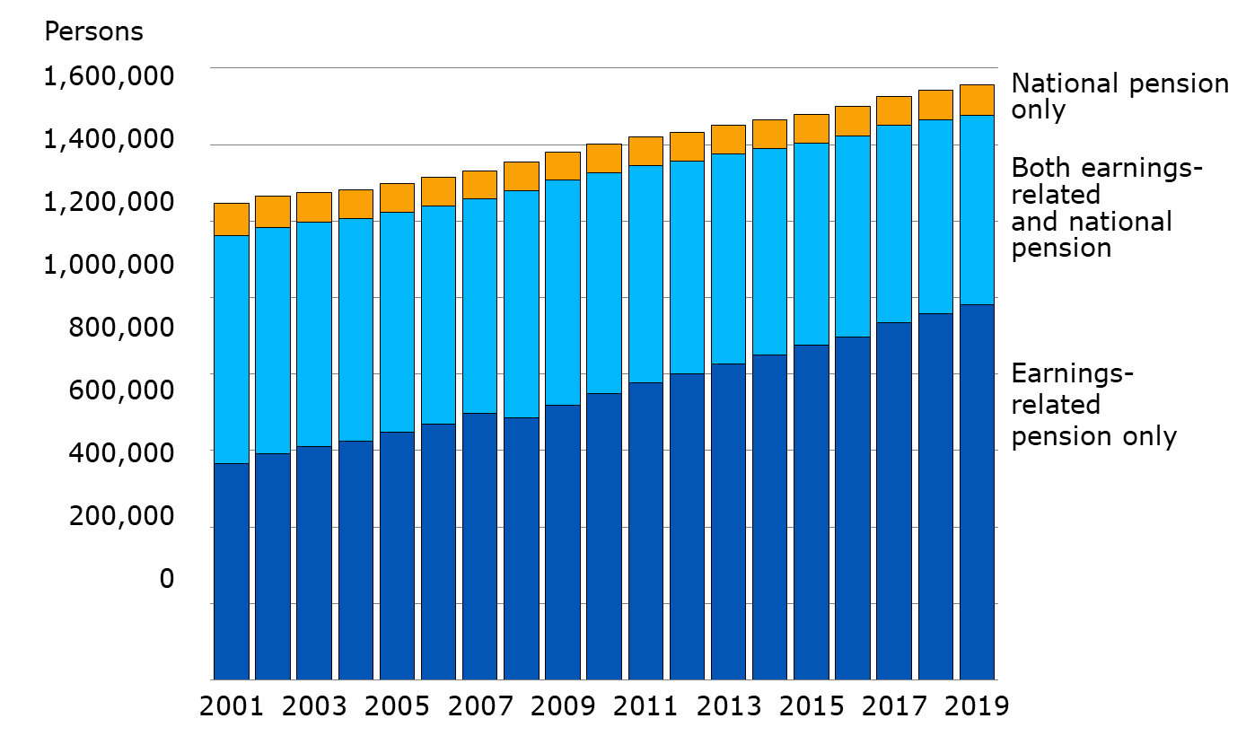
Pension recipients by pension structure in 2000–2019
Notes:
The figures in the graph include all pension recipients residing in Finland receiving pension from the statutory earnings-related or national pension scheme.
Statistical database
https://tilastot.etk.fi/pxweb/en/ETK/ETK__110kaikki_elakkeensaajat__10elakkeensaajien_lkm/elsa_k04_rak.px
Statistical Yearbook of Pensioners in Finland
https://www.etk.fi/en/statistics-2/statistics/pension-recipients/all-pension-recipients/

Slide 33
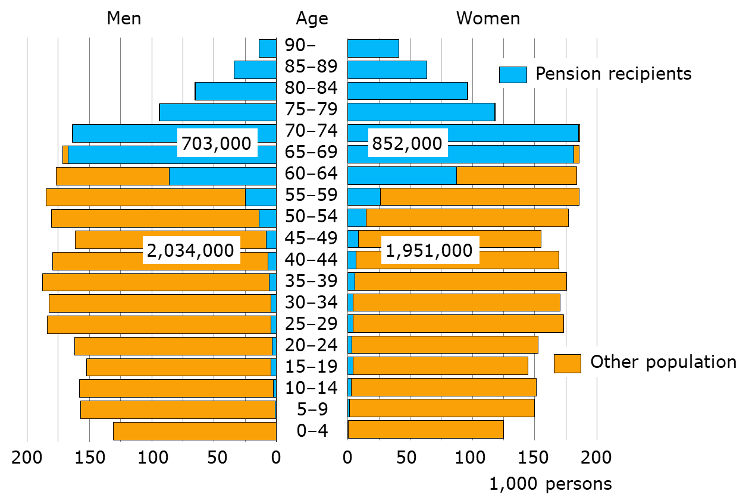
Total population and pension recipients on 31 Dec. 2019
Notes:
Pension recipients: individuals residing in Finland who receive an old-age, disability, survivors’ and part-time pension, as well as farmer’s special pension, paid from the statutory earnings-related or national pension scheme.
Population: Population insured by Kela
Statistical database
https://tilastot.etk.fi/pxweb/en/ETK/ETK__110kaikki_elakkeensaajat__10elakkeensaajien_lkm/elsa_k02_laji.px
Statistical Yearbook of Pensioners in Finland
https://www.etk.fi/en/statistics-2/statistics/pension-recipients/all-pension-recipients/

Slide 34
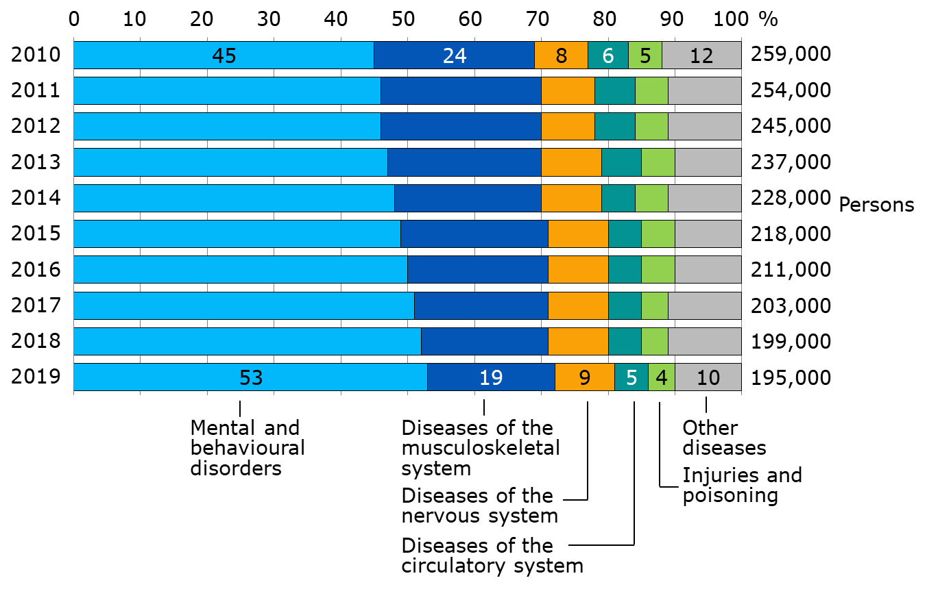
Recipients of disability pension by main disease category in 2010–2019
Notes:
The figures include individuals residing in Finland who have received a disability pension from the statutory earnings-related or national pension scheme.
The disability pensions include the actual disability pensions and the individual early retirement pensions (in 2010) and as of 2018 the years-of-service pensions.
Actual disability pension: A pension granted until further notice or a cash rehabilitation benefit (fixed-term disability pension). Both can be granted allso to the amount of a partial pension in the earnings-related pension scheme.
Statistical database
https://tilastot.etk.fi/pxweb/en/ETK/ETK__110kaikki_elakkeensaajat__10elakkeensaajien_lkm/elsa_k10_tk_diag.px
Statistical Yearbook of Pensioners in Finland
https://www.etk.fi/en/statistics-2/statistics/pension-recipients/all-pension-recipients/

Slide 35
Retirees on Earnings-related Pensions and Effective Retirement Age

Slide 36
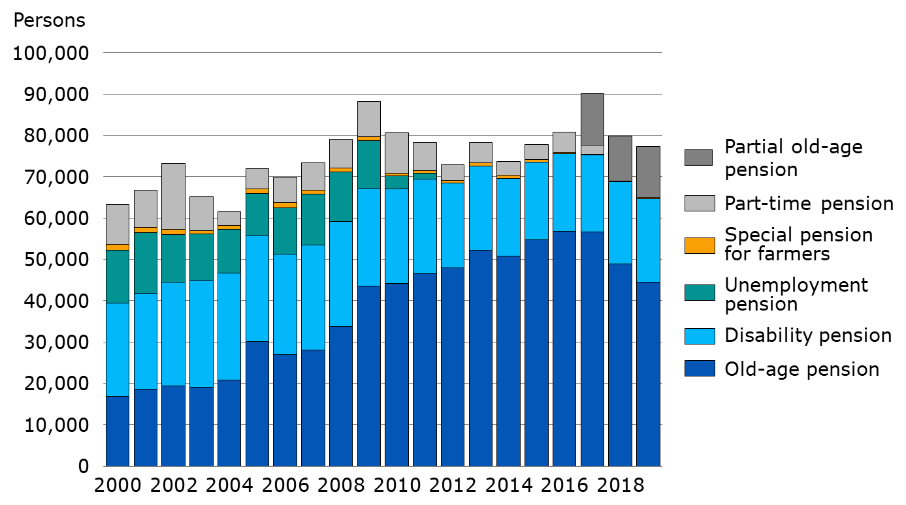
New retirees on earnings-related pension in 2000–2019, by pension benefit
Notes:
The numbers in the figure refer to new retirees on a statutory earnings-related pension.
New retirees on the old-age pension includes only individuals who have retired directly on an old-age pension or whose part-time pension has been converted to an old-age pension.
Individuals who have retired on the partial old-age pension (taking out 25% or 50% of their accrued pension) are not considered new retirees. They will be included in the figure for new retirees on an old-age pension when they retire on a full old-age pension.
Statistical database
https://tilastot.etk.fi/pxweb/en/ETK/ETK__120tyoelakkeensaajat__40tyoelakkeelle_siirtyneiden_lkm/elsi_t01_laji.px
Earnings-related pension recipients in Finland
https://www.etk.fi/en/statistics-2/statistics/pension-recipients/earnings-related-pension-recipients/

Slide 37
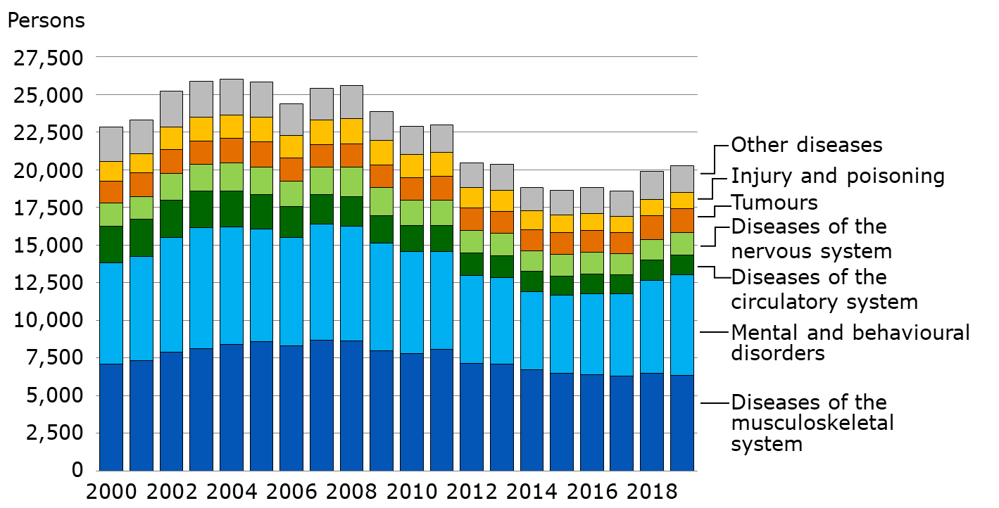
New retirees on an earnings-related disability pension in 2000–2019, by main disease category
Notes:
The figures in the graph concerns individuals who have retired on a statutory earnings-related pension.
The disability pensions include the actual disability pensions and the individual early retirement pensions (in 2000–2006) and as of 2018 the years-of-service pensions.
Actual disability pension: a pension granted until further notice and a cash rehabilitation benefit (fixed-term disability pension). Both can be granted allso to the amount of a partial pension.
Statistical database
https://tilastot.etk.fi/pxweb/en/ETK/ETK__120tyoelakkeensaajat__40tyoelakkeelle_siirtyneiden_lkm/elsi_t10_tk_diag.px
Earnings-related pension recipients in Finland
https://www.etk.fi/en/statistics-2/statistics/pension-recipients/earnings-related-pension-recipients/

Slide 38
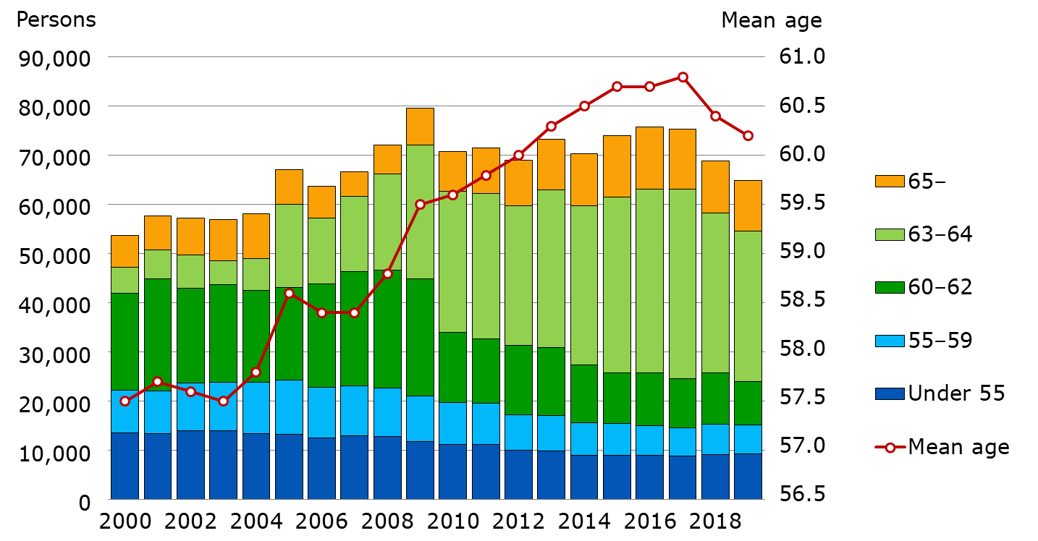
New retirees on an earnings-related pension in 2000–2019, by age group and mean age
Notes:
The figures in the graph concerns individuals who have retired on a statutory earnings-related pension.
New retirees on old-age pension (includes only persons who have retired directly on old-age pension or whose part-time pension has been converted to an old-age pension), disability pension, unemployment pension (2000–2011) and special pension for farmers.
Individuals who have retired on a part-time pension are not counted as new retirees since receiving part-time pension requires working.
Individuals who have retired on a partial old-age pension (taking out 25% or 50% of their accrued pension) are not considered new retirees. They will be included in the figure for new retirees on an old-age pension when they retire on a full old-age pension.
Statistical database
https://tilastot.etk.fi/pxweb/en/ETK/ETK__120tyoelakkeensaajat__40tyoelakkeelle_siirtyneiden_lkm/elsi_t01_laji.px
https://tilastot.etk.fi/pxweb/en/ETK/ETK__130elakkeellesiirtymisika/esiirtymisika02.px
Earnings-related pension recipients in Finland
https://www.etk.fi/en/statistics-2/statistics/pension-recipients/earnings-related-pension-recipients/

Slide 39
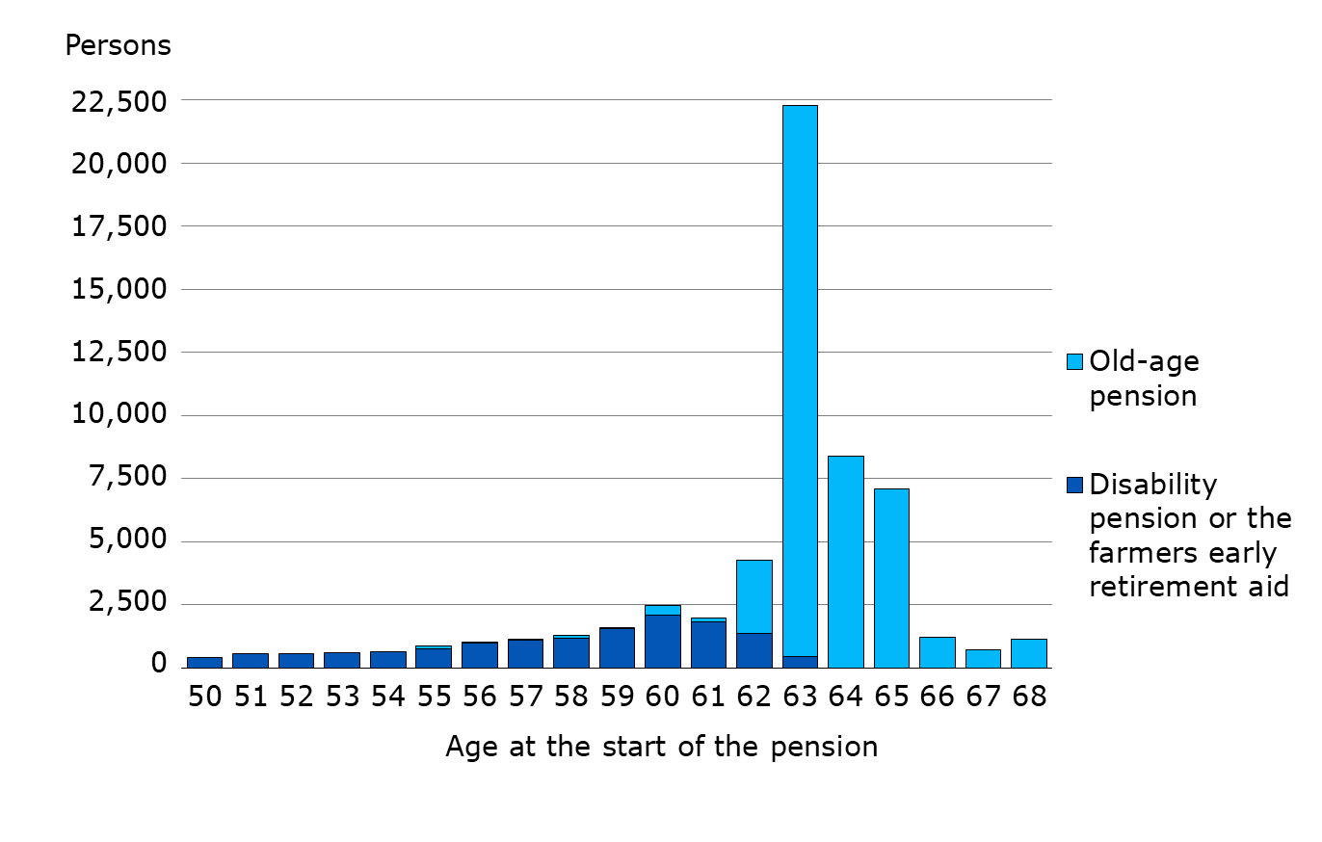
New retirees on an earnings-related pension in 2019, aged 50–68
Notes:
The figures in the graph concerns individuals who have retired on a statutory earnings-related pension.
Individuals who have retired on a partial old-age pension (taking out 25% or 50% of their accrued pension) are not considered new retirees. They will be included in the figure for new retirees on an old-age pension when they retire on a full old-age pension.
Statistical database
https://tilastot.etk.fi/pxweb/en/ETK/ETK__120tyoelakkeensaajat__40tyoelakkeelle_siirtyneiden_lkm/elsi_t01_laji.Px

Slide 40
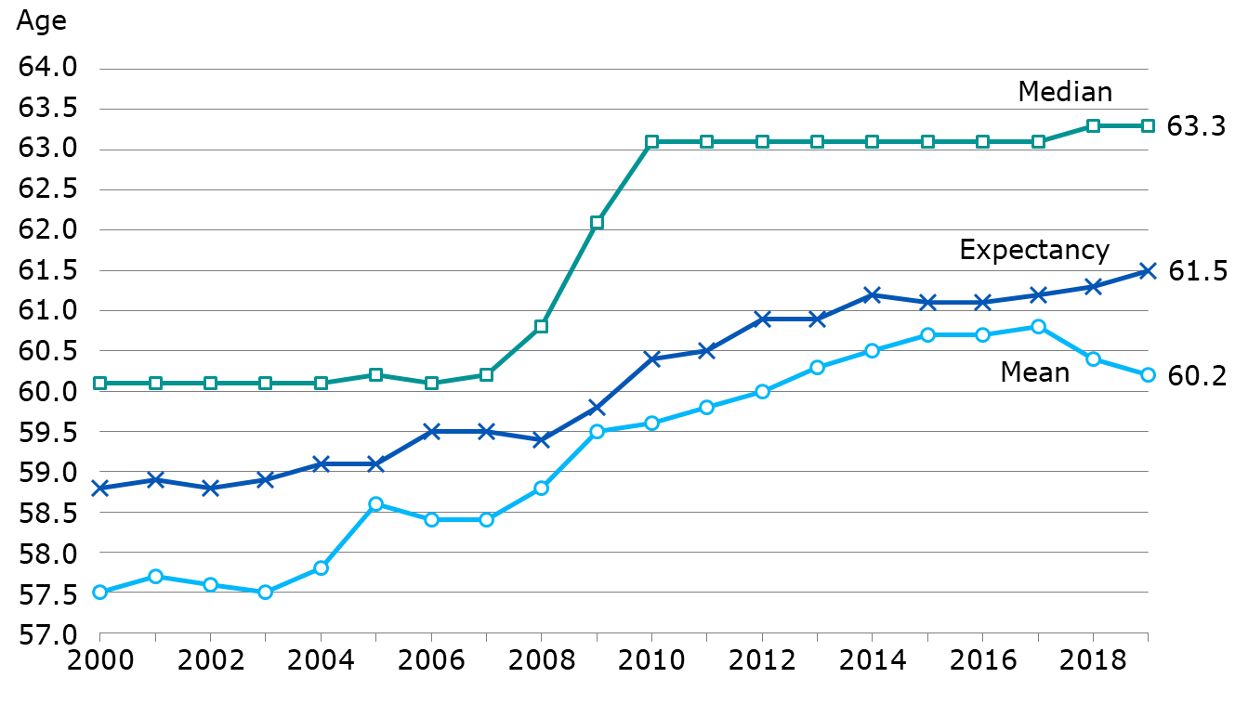
Effective retirement age in earnings-related pension scheme in 2000–2019
Notes:
The figures in the graph concerns individuals who have retired on a statutory earnings-related pension.
New retirees on old-age pension (includes only persons who have retired directly on old-age pension or whose part-time pension has been converted to an old-age pension), disability pension, unemployment pension (2000–2011) and special pension for farmers.
The figures in the graph do not include new retirees on a part-time pension or a partial old-age pension.
The median age is the middle observation of the data, i.e. half of the new retirees are younger than this while half are older.
The mean age is the arithmetical average age of the new retirees.
The expected effective retirement age is an indicator developed a longside the traditional average and median age. It is better suited to monitor the changes in retirement ages. The expected effective retirement age is the average retirement age, which is formed for insured individuals of a certain age if the age-cohort-specific retirement and mortality rates remain at the level of the review year. The expectancy is independent of age structure. In the graph, the expected effective retirement age has been calculated for a 25-year-old, and it depicts the retirement age of the entire population insured for an earnings-related pension.
Statistical database
https://tilastot.etk.fi/pxweb/en/ETK/ETK__130elakkeellesiirtymisika/esiirtymisika01.px
Effective retirement age
https://www.etk.fi/en/statistics-2/statistics/effective-retirement-age/

Slide 41
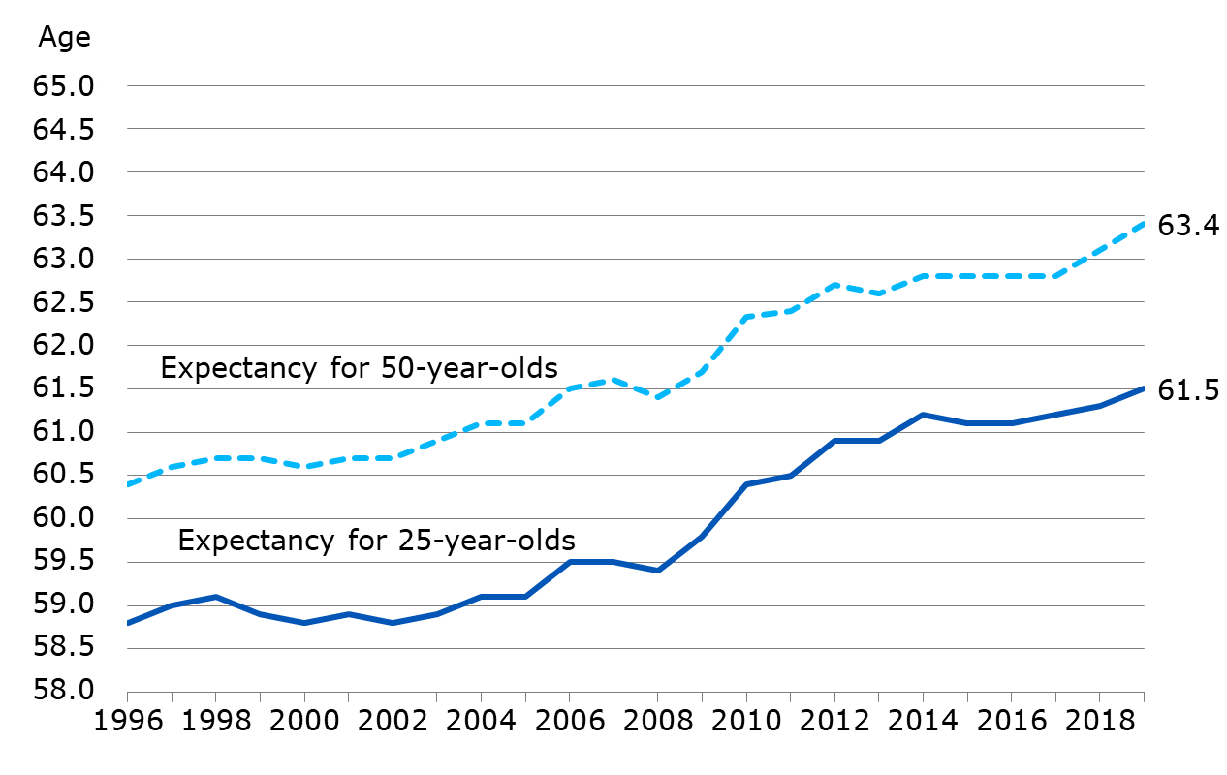
Expected effective retirement age in earnings-related pension scheme in 1996–2019
Notes:
The expected effective retirement age is an indicator developed alongside the traditional average and median age. It is better suited to monitor the changes in retirement ages.
The expected effective retirement age is the average retirement age, which is formed for insured individuals of a certain age if the age-cohort-specific retirement and mortality rates remain at the level of the review year. The expectancy is independent of age structure.
In the graph, the expected effective retirement age has been calculated for a 25-year-old and a 50-year-old separately. The expectancy for the 25-year-old depicts the retirement age of the entire population insured for an earnings-related pension. The expectancy for a 50-year-old has been calculated based on all insured aged 50.
Statistical database
https://tilastot.etk.fi/pxweb/en/ETK/ETK__130elakkeellesiirtymisika/esiirtymisika01.px
Effective retirement age
https://www.etk.fi/en/statistics-2/statistics/effective-retirement-age/

Slide 42
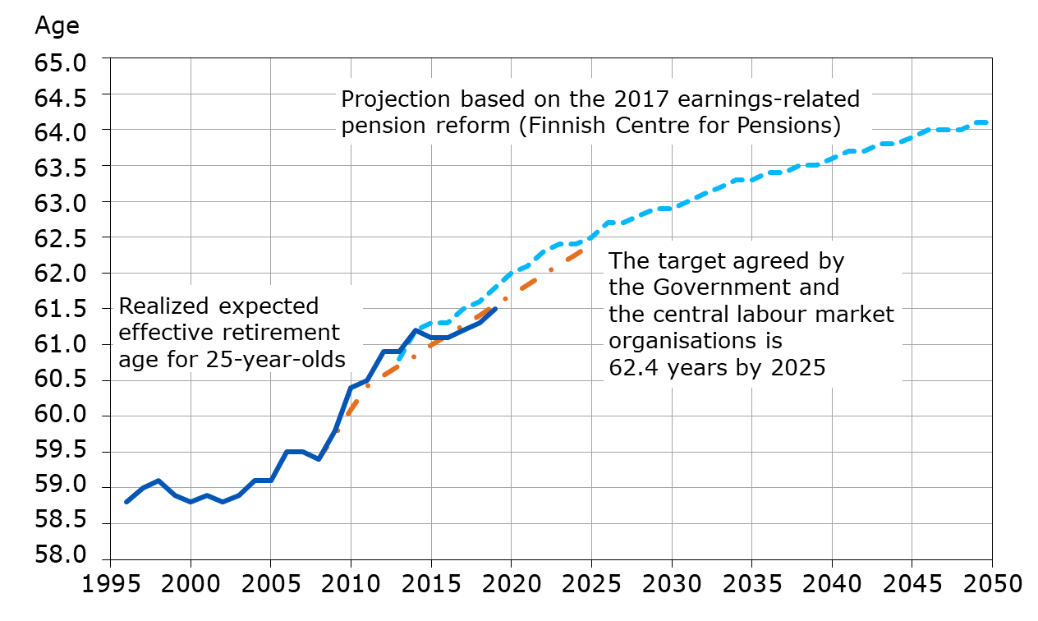
Expected effective retirement age in 1996–2050, aims and realization
Notes:
Pension Indicators
https://www.etk.fi/en/julkaisu/pension-indicators/

Slide 43
Rehabilitation within the Earnings-related Pension Scheme
Notes:
Rehabilitation within the earnings-related pension scheme is vocational rehabilitation arranged and paid for by the pension providers. The aim of the rehabilitation is to prevent disability and thus improve the preconditions for working when employees are no longer able to continue in their former work due to their state of health.
Vocational rehabilitation is individual and can take the form of a work trial at the workplace, retraining for a new profession or a livelihood support.
During rehabilitation, an income compensation is paid. If you are an emloyee or a self-employed person, you will receive a rehabilitation allowance, but if you are retired, you will receive a rehabilitation increment.
Statistical database
https://tilastot.etk.fi/pxweb/en/ETK/ETK__160tyoelakekuntoutus/?tablelist=true&rxid=9e39c227-ba91-46fa-ae55-42ed33f70d8e
Rehabilitation
https://www.etk.fi/en/statistics-2/statistics/rehabilitation/

Slide 44
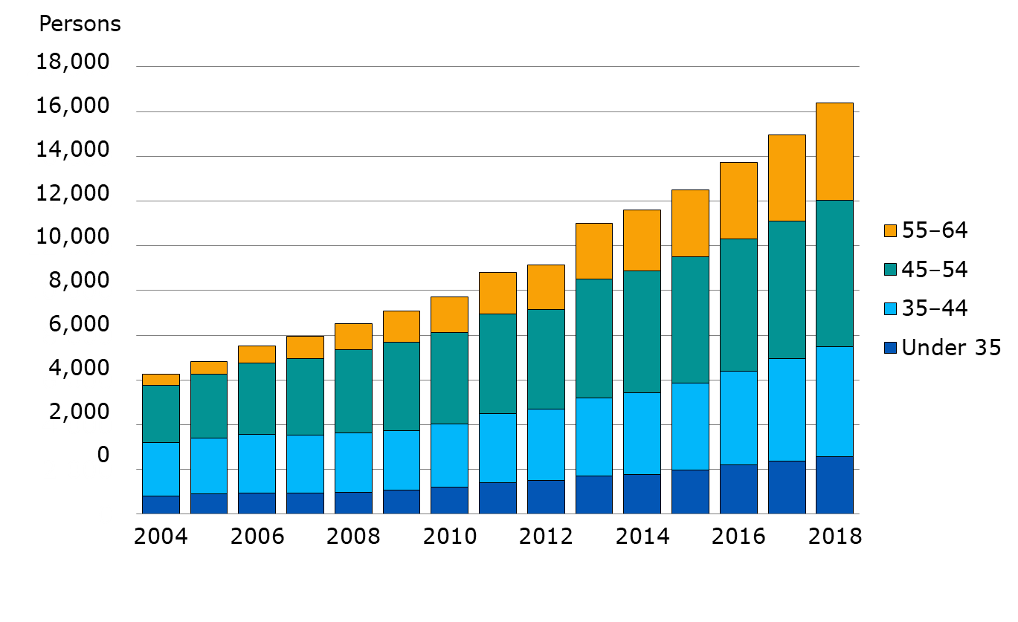
Rehabilitees by age in 2004–2018
Notes:
In 2018, the average age of rehabilitees was 47. Of all rehabilitees, 57 per cent were women.
Statistical database
https://tilastot.etk.fi/pxweb/en/ETK/ETK__160tyoelakekuntoutus/kuntoutus01.Px
Rehabilitation
https://www.etk.fi/en/statistics-2/statistics/rehabilitation/

Slide 45
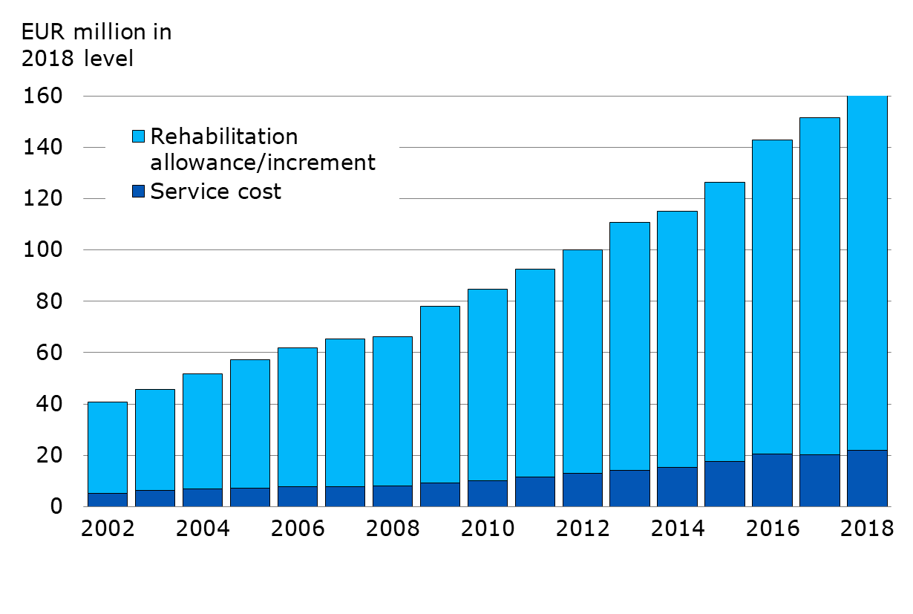
Rehabilitation expenses in 2002–2018
Notes:
The total rehabilitation expenses consist of the income compensation paid during rehabilitaiton (rehabilitation assistance, rehabilitation allowance, rehabilitation increment) and rehabilitation service expenses. In 2018, the average income compensation was EUR 2,706 /month.
Statistical database
https://tilastot.etk.fi/pxweb/en/ETK/ETK__160tyoelakekuntoutus/kuntoutus02.px
Rehabilitation
https://www.etk.fi/en/statistics-2/statistics/rehabilitation/

Slide 46
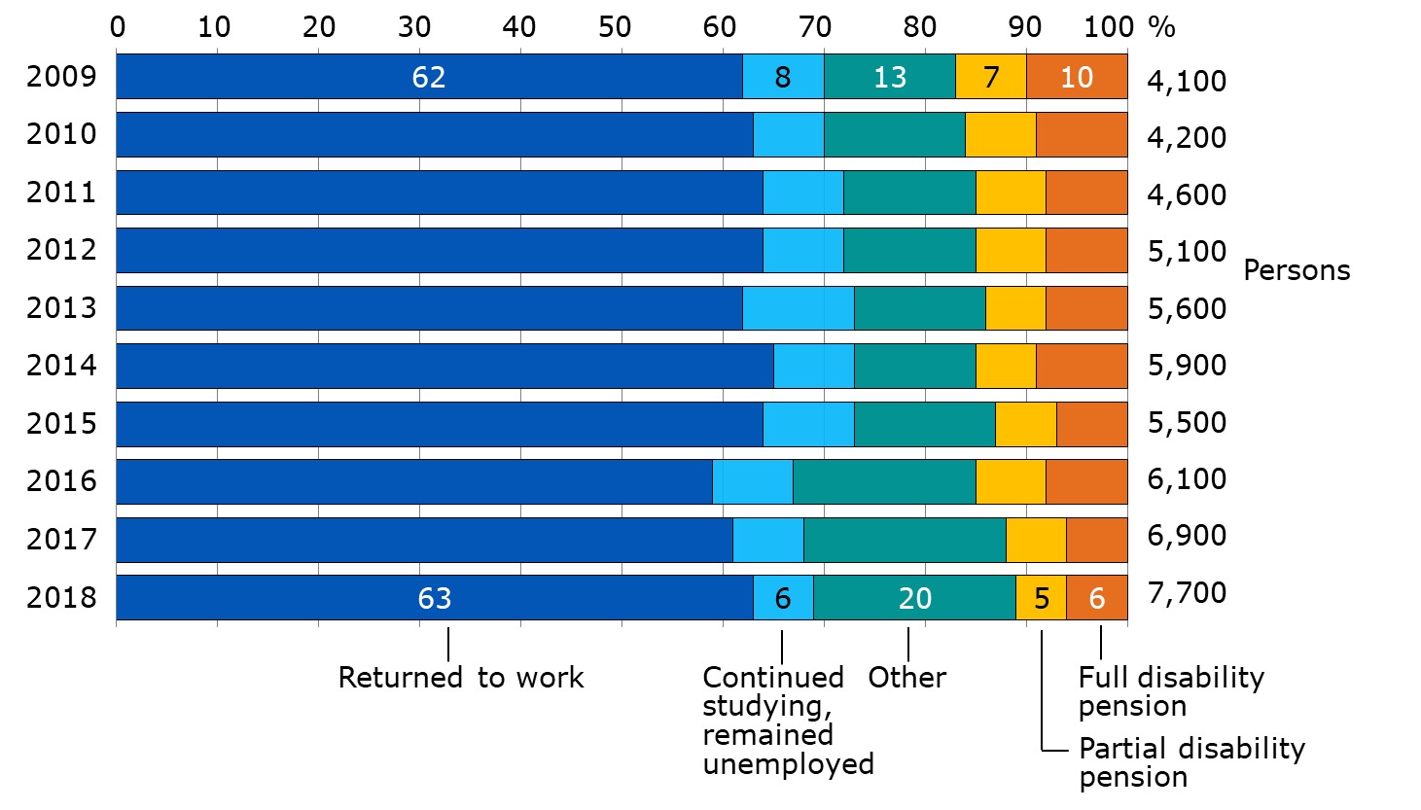
Post-rehabilitation status in 2009–2018
Notes:
The graph depicts the direct results following rehabilitation that has been completed in the last 10 years. The results are based on data received from pension providers, not the register data of the Finnish Centre for Pensions.
Direct results of rehabilitation
Returned to work: the individual returned to his or her previous work or the planned work as a result of the rehabilitation.
Continued studiying, remained unemployed: The rehabilitation in itself was successful, but the individual continues studying or remains unemployed.
Other: The rehabilitation was terminated, reason unknown; the person has been transferred under the scope of the workers’ compensation insurance or motor liability insurance etc.
Partial disability pension: The individual receives a partial disability pension.
Full disability pension: The individual receives a full disability pension.
Rehabilitation
https://www.etk.fi/en/statistics-2/statistics/rehabilitation/

Slide 47
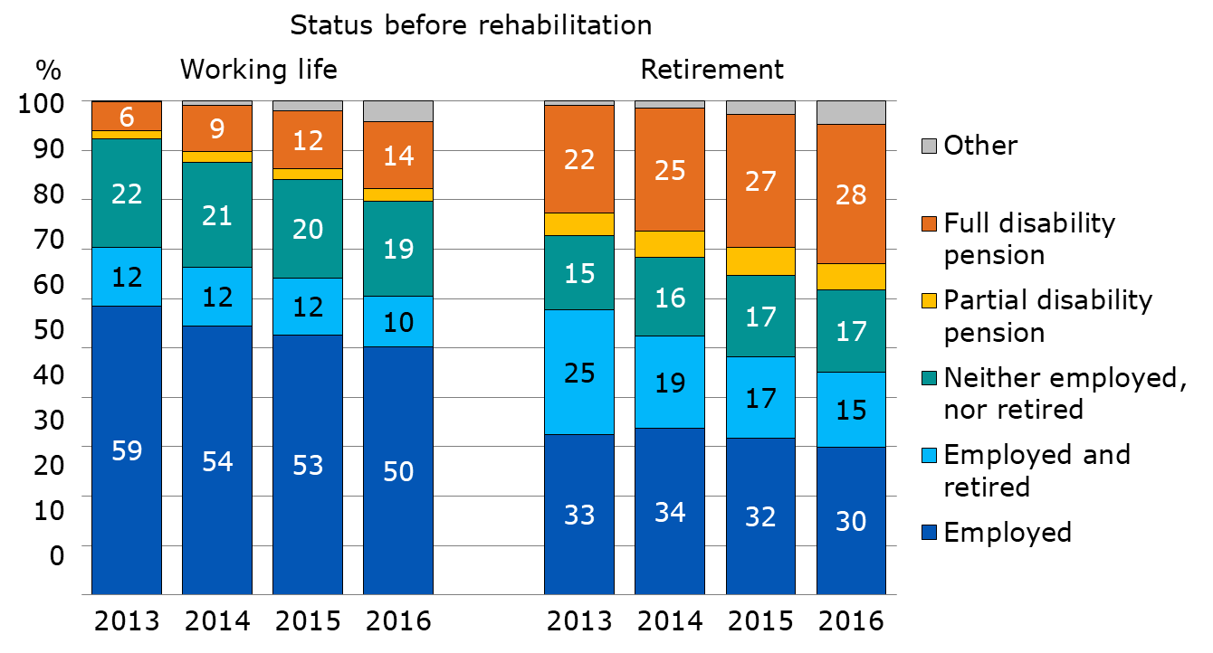
Continuing at work, employees ending rehabilitation in 2013
Notes:
The graph depicts the status (mainly in terms of the permanence of employment or retirement) of individuals whose rehabilitation has ended. The data is based on the registers of the pension providers.
Employed The individual is only employed.
Employed and retired: The individual works while being retired. The pension received may be a partial or full disability pension or some other form of pension.
Neither employed nor retired: The individual is unemployed or studies.
Partial disability pension, full disability pension: The individual is only retired and not in employment.
Other: Other pension than disability pension (not in employment), dead.
Rehabilitation
https://www.etk.fi/en/statistics-2/statistics/rehabilitation/

Slide 48
Financing of Earnings-related Pensions

Slide 49
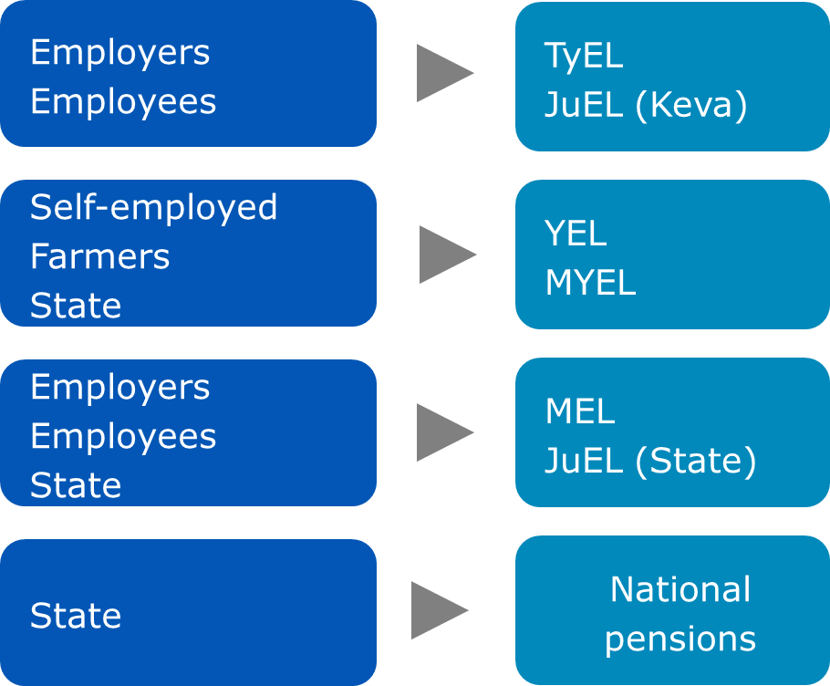
Financing of pensions, by pension act
Notes:
State funds are used to finance the expenses of VEKL benefits relating to the care of one’s own child under the age of three or to studying, as well as relating management expenses. The VEKL benefits totalled about EUR 7.9 million in 2019.

Slide 50
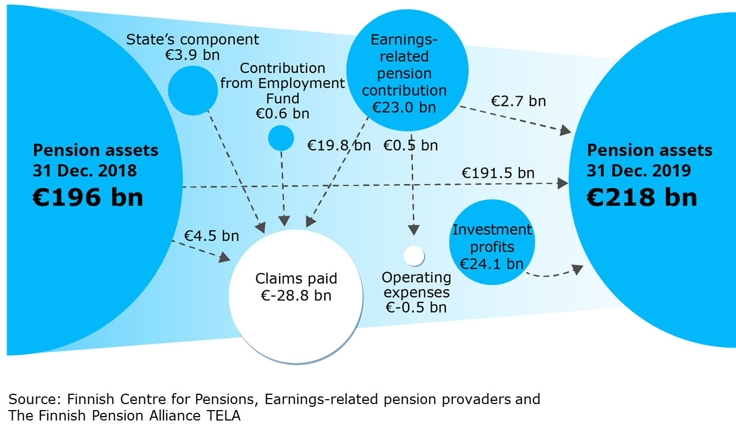
Money flows of earnings-related pension scheme 2019 (advance notice)
Notes:
The Finnish statutory pension provision is financed mainly with earnings-related pension contributions paid by employers, employees, self-employed persons and farmers, as well as a with accrued pension assets and investment returns.
Parts of some of the pensions are financed with state payments and contributions paid by the Unemployment Insurance Fund (from 2019 Employment Fund) to the earnings-related pension scheme.
Statistical database
https://tilastot.etk.fi/pxweb/en/ETK/ETK__180tyoelakkeiden_rahoitus__10rahavirrat/rahavirrat01_kaikki.px

Slide 51
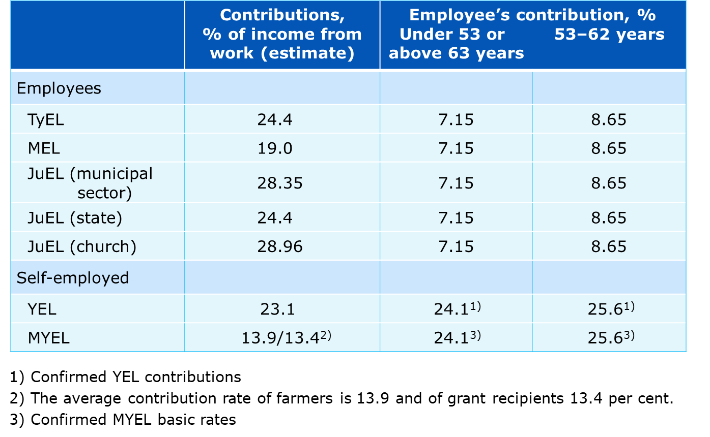
Earnings-related pension contribution rates in 2020
Notes:
TyEL = Employees Pensions Act
MEL = Seafarer’s Pensions Act
JuEL (municipal sector)) = Public Sector Pensions Act (local government employees)
JuEL (state) = Public Sector Pensions Act (State employees)
JuEL (church) = Public Sector Pensions Act (Evangelical Lutheran Church employees)
YEL = Self-employed Persons’ Pensions Act
MYEL = Farmers’ Pensions Act
The Ministry of Social Affairs and Health confirms the earnings-related contribution rates annually.
JuEL (municipal sector) contribution includes the components based on wage and pension expenditure.
In addition to the Church contribution, a pension fund contribution. In 2020, it is 5% of the Church tax.
The contribution rates confirmed for the self-employed and farmers are linked to the average TyEL contribution.
The contribution rate for a self-employed person who has turned 53 is applied as of the beginning of the year after they turn 53 years and continues until the end of the calendar year in which they turn 63 years.

Slide 52
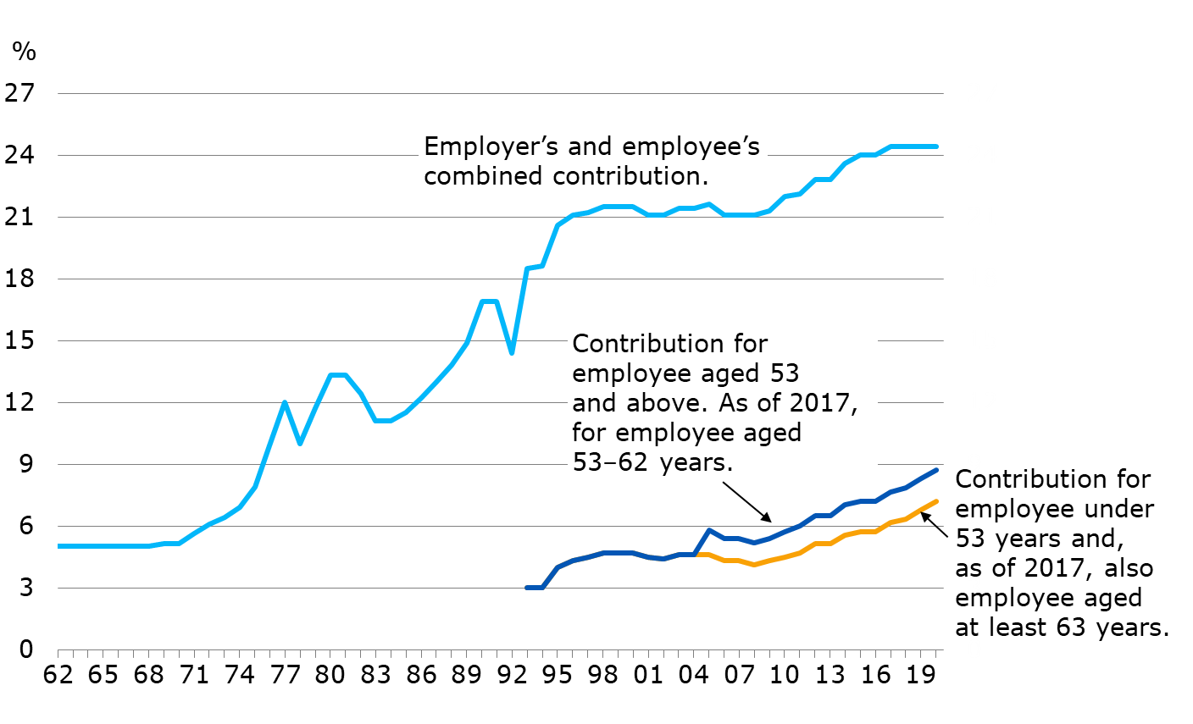
Average TEL-/TyEL contribution in 1962–2020
Notes:
Between 1962 and 1992 only employers paid pension contributions. The contribution level was low to begin with but rose as of the 1970s.
Employees started contributing towards their pension in 1993. At the same time, it was agreed that any increases to the contributions be divided fifty-fifty between the employer and the employee.
Between 2005 and 2016 the contribution rate of those who had turned 53 years was higher than for younger employees. As of 2017 the contribution rate ha bee higher for employees aged 53–62 years.
The competitiveness pact that took effect as of the beginning of 2017 resulted in a shift of 0.2 percentage points from the employer’s contribution to the employee’s contribution.

Slide 53
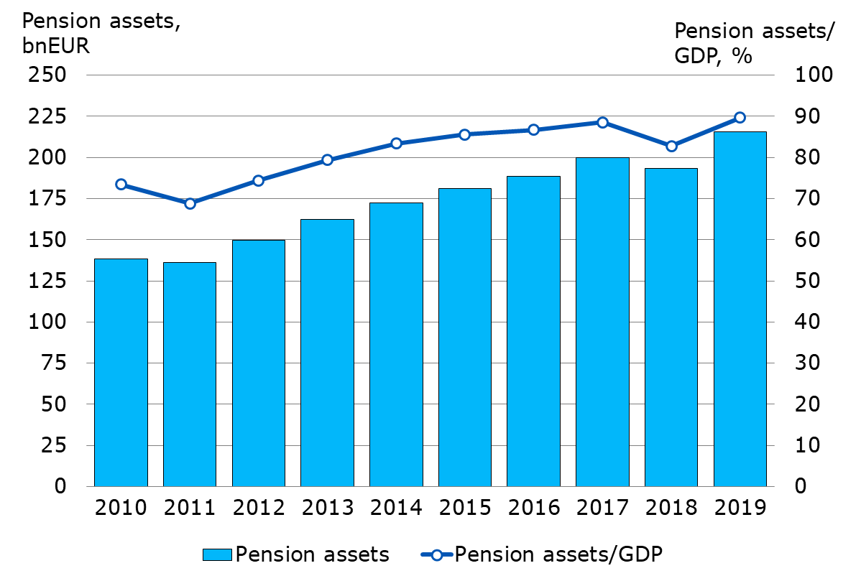
Pension assets and ratio of pension assets to GDP in 2010–2019
Notes:
Sources:
GDP: Statistics Finland
Pension Assets: The Finnish Pension Alliance TELA

Slide 54
Investment Operations of Pension Providers

Slide 55
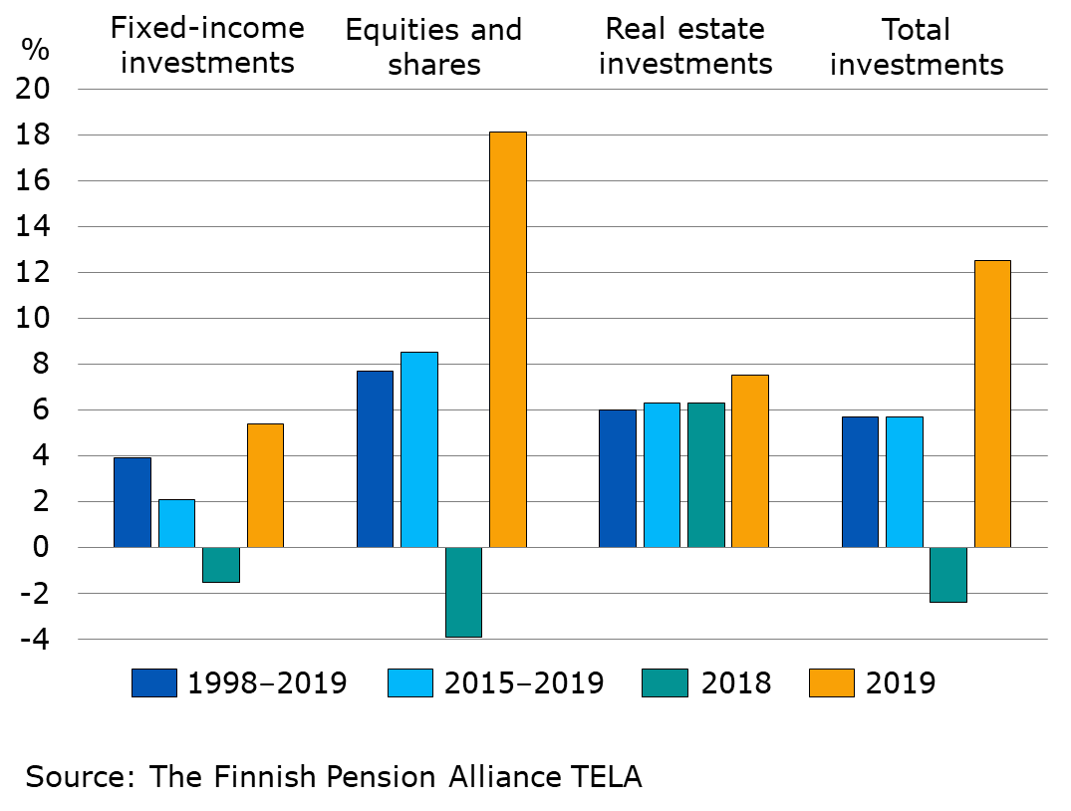
Return on earnings-related pension investments at current values in 1998–2019
Notes:
The current value return is obtained by adding the change in valuation differences during the year to the euro-denominated return minus investment expenses, as shown in the profit and loss account. The rate of return is obtained by dividing this euro-denominated return by the euro-denominated market value of the investment assets.
The market value of the investment assets, used as the divisor, can be calculated accurately by considering the time that the capital has been tied up in the asset category in question.
Source: The Finnish Pension Alliance TELA

Slide 56
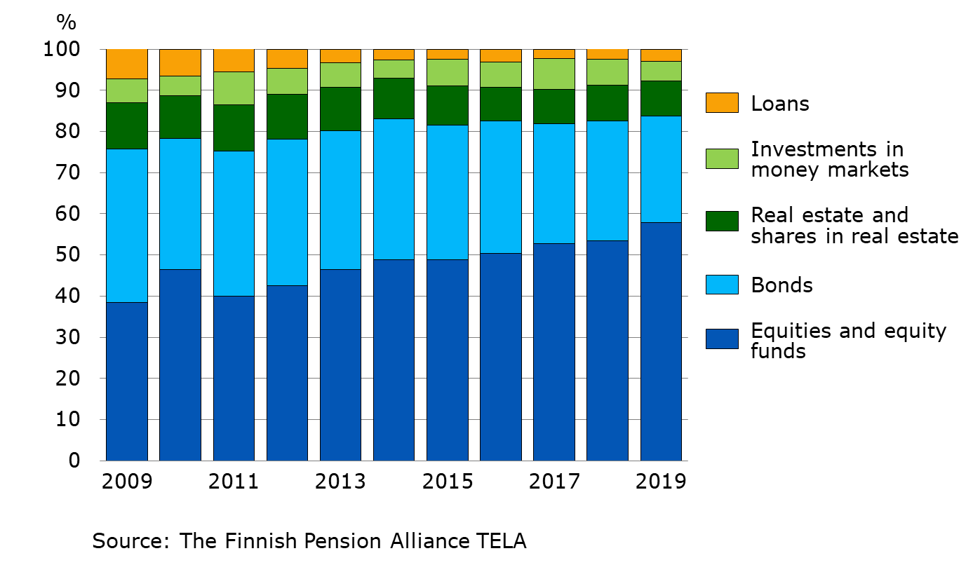
Earnings-related pension investments, by asset class in 2009–2019
Notes:
Source: The Finnish Pension Alliance TELA

Slide 57
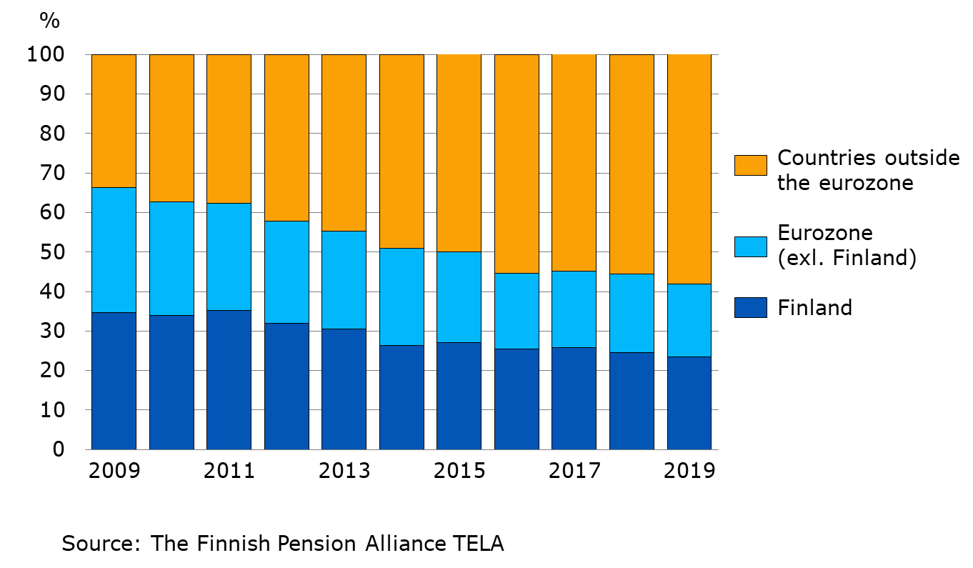
Earnings-related pension investments, by region in 2009–2019
Notes:
Source: The Finnish Pension Alliance TELA

